Slide 1
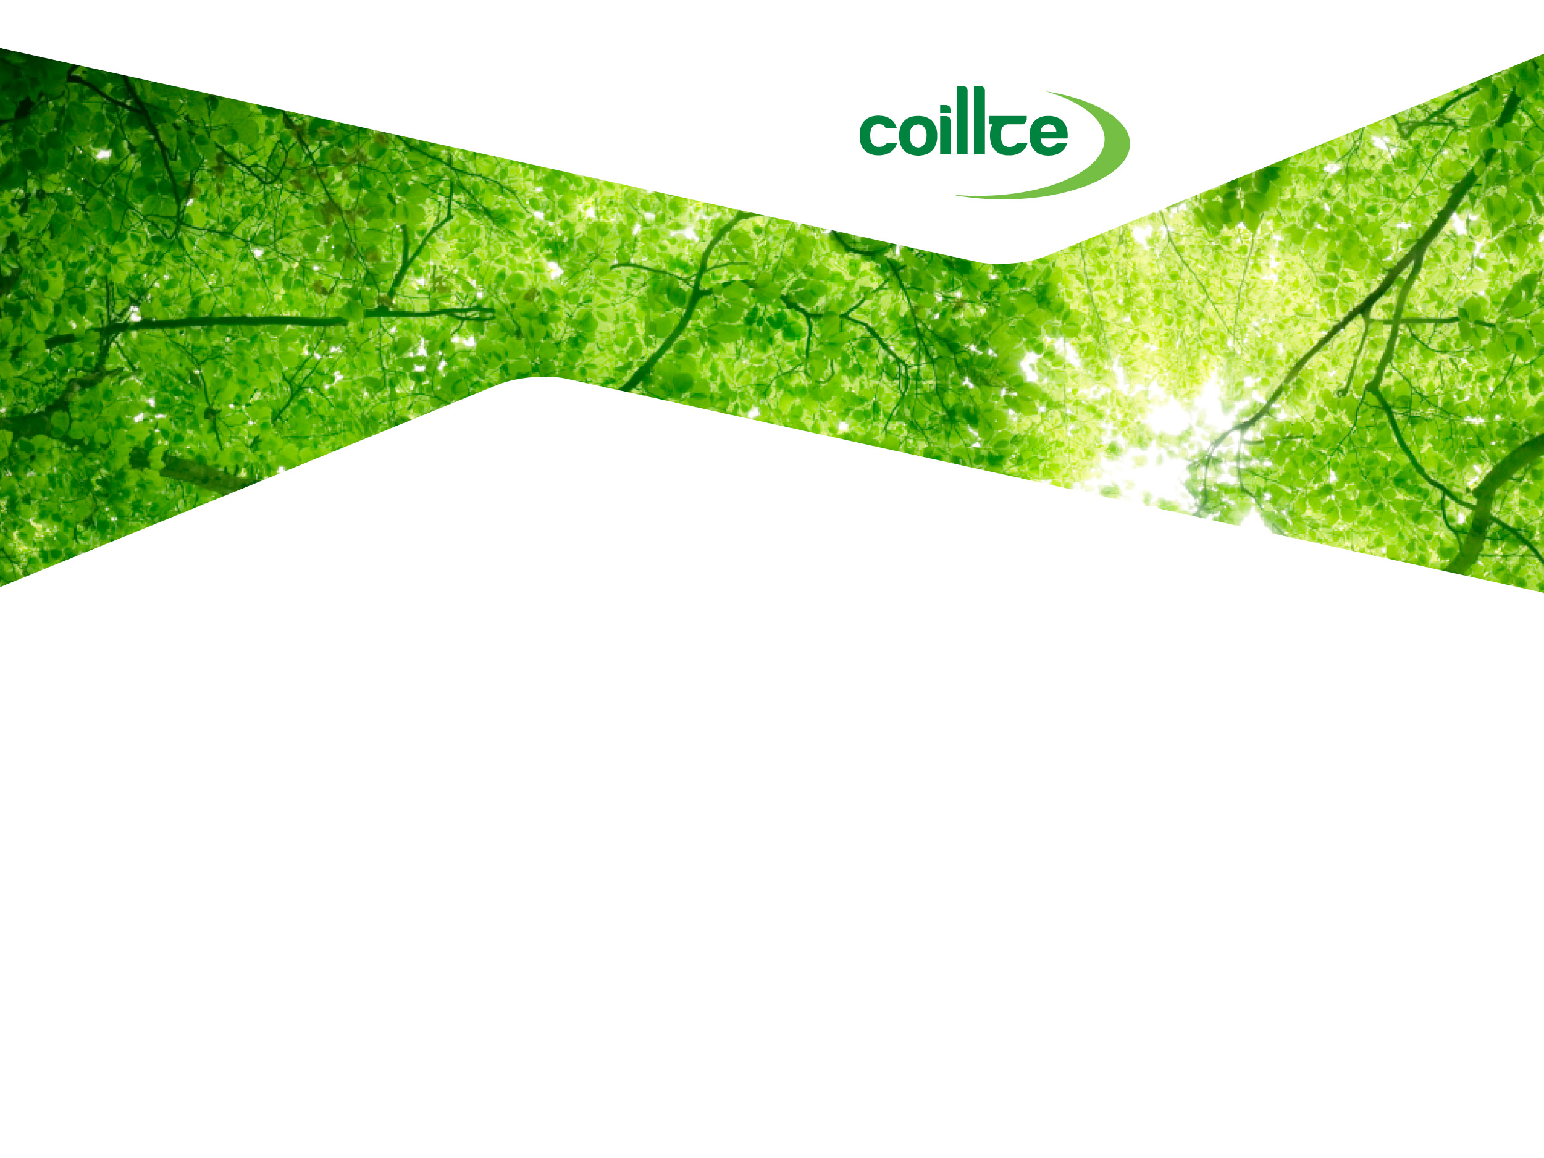
^{Past LIFE Experiences}
^{Dr Aileen O’Sullivan}
^{Ecologist,} ^{Stewardship and Public Goods}
^{29th September 2015}

Slide 2
^{This presentation}
Overview of Coillte’s LIFE Projects
Lessons learned
The future?

Slide 3
Overview of LIFE projects
EU LIFE – Rebuilding Ireland’s Natural Capital

Slide 4
^{Sustainable Forest Management}
“Valuable woodland and other semi-natural habitats … which have been colonised, planted, or incorporated into plantations, but which have retained their ecological characteristics (or have a high potential to be restored), shall be identified and restored or treated in a manner that does not lead to further loss of biodiversity or cultural value.”
UKWAS, 2000

Slide 5
^{Clever ideas}
Caledonian Partnership
  Highland Birchwoods
  Scottish Natural Heritage
  The Forestry Commission
  Countryside Commission for Wales
  The National Trust
  Royal Society for the Protection of Birds
  Centre for Ecology and Hydrology

Slide 6
^{Coillte estate – soil types}

Slide 7
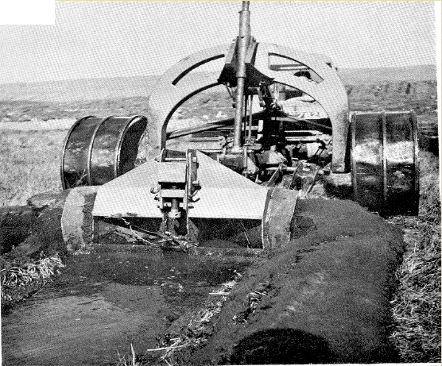
^{Afforestation of peatlands}

Slide 8
Derry, Co. Mayo

Slide 9
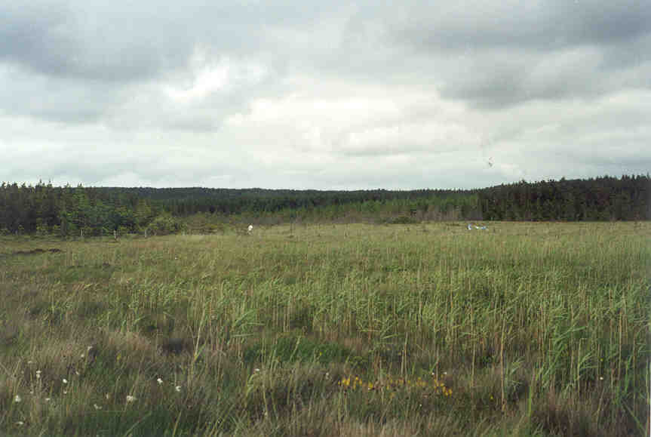
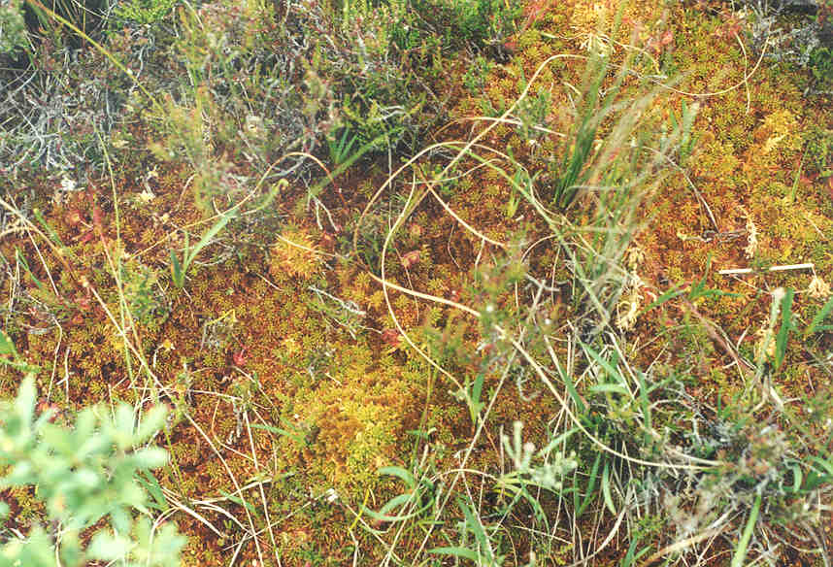
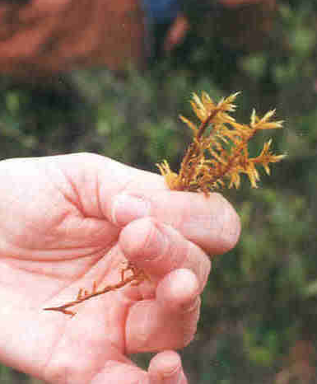
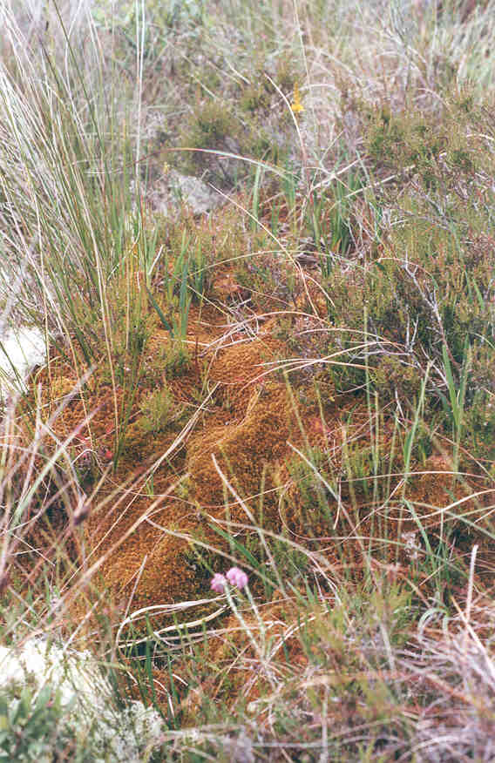
^{Blanket bog flush, Co. Mayo}
Sphagnum imbricatum
Homalothecium nitens
Sphagnum fuscum

Slide 10
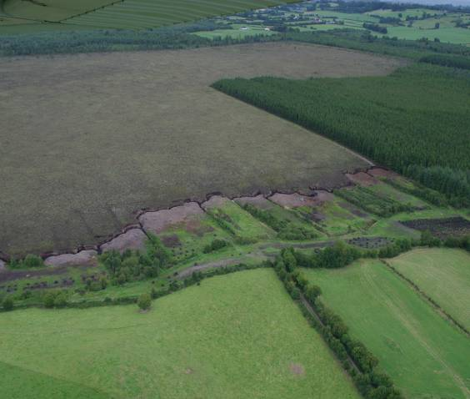
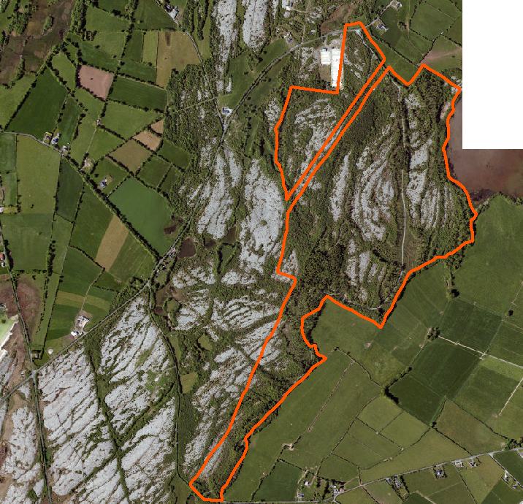
^{Other rare habitats}
Rare native woodlands
Raised bog

Slide 11
Dates | LIFE Project | Site Size Range (ha) | Total Hectares
2002-2007 | Blanket Bog | 18-364 | 1,967
2004-2008 | Raised Bog (1st) | 7-132 | 600
2006-2009 | Priority Woodland Habitats | 6-293 | 551
2011-2015 | Raised Bog (2nd) Coillte / NPWS | 4-101 | 685
TOTAL | Bogs Woodlands |  | 3,252 551

Slide 12
^{Overall approach}
Select suitable sites
  Within SACs
  Contain rare (EU Annex 1) habitats with strong restoration potential
Remove plantation conifers
Create the right conditions for natural development
  Remove invasive shrubs (rhodo, laurel)
  Control grazers (deer)
  Block drains (bogs, wet woodlands)
Notes:
UKWAS, 2000?

Slide 13
Lessons learned
EU LIFE – Rebuilding Ireland’s Natural Capital

Slide 14
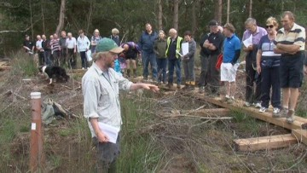
LIFE is as much about people as it is about ecology and habitats
Notes:
Blanket bog project
Large sites
Exc potential – vg bog, flushes, rare mosses
Coillte’s capability
Had the sites
Had the staff
Can-do attitude
Contacts, contractors – practical knowledge
Big learning experience
Not just the sites that benefitted – lasting people connections were made too…

Slide 15
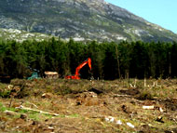
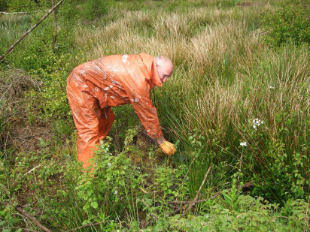
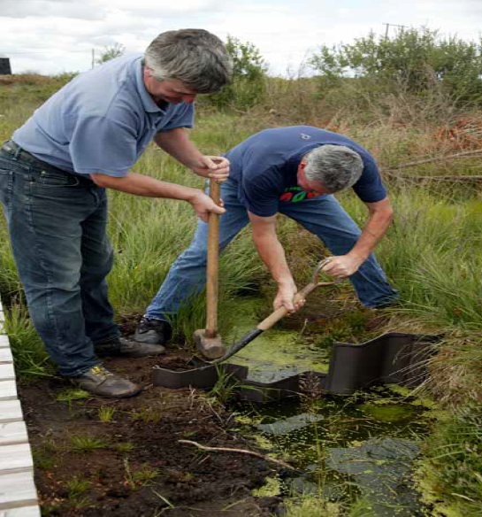
Success in LIFE comes down to hard work
Notes:
Blanket bog project
Large sites
Exc potential – vg bog, flushes, rare mosses
Coillte’s capability
Had the sites
Had the staff
Can-do attitude
Contacts, contractors – practical knowledge
Big learning experience
Not just the sites that benefitted – lasting people connections were made too…

Slide 16
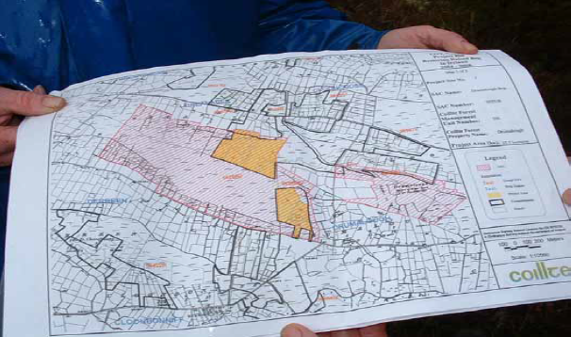
For success in LIFE, be careful about the sites you choose
NPWS information
Coillte sources:
  GIS: properties in SACs
  Inventory
  Biodiversity areas
  Local staff knowledge
  Ecological assessments

Slide 17

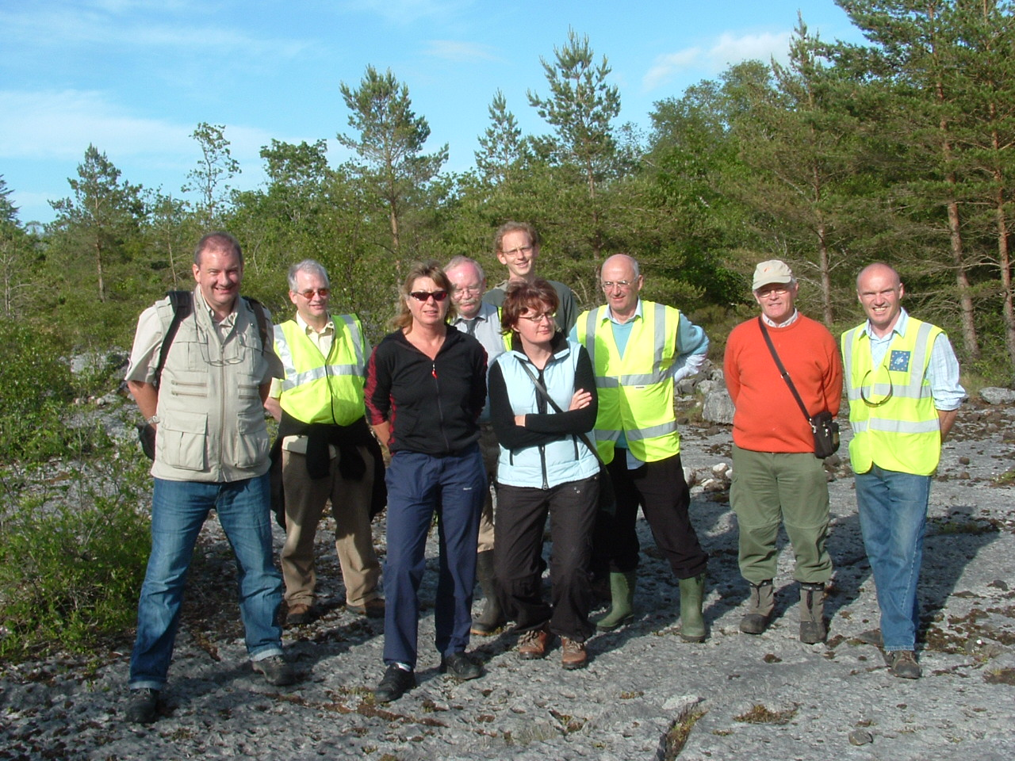
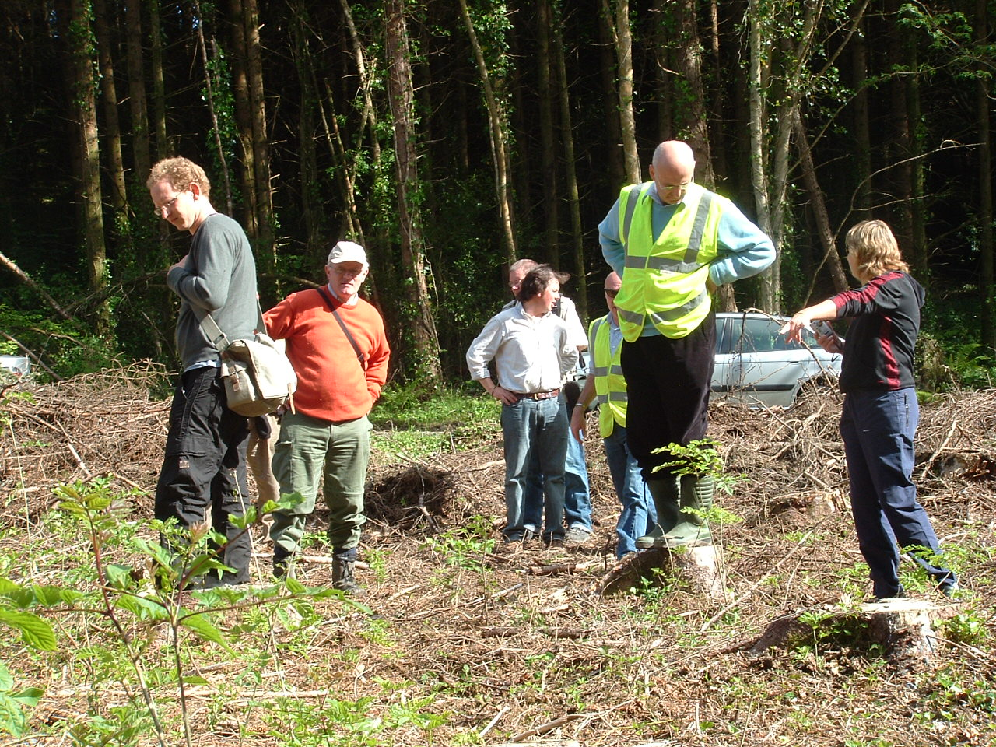
Strive to keep your LIFE objectives clear

Slide 18
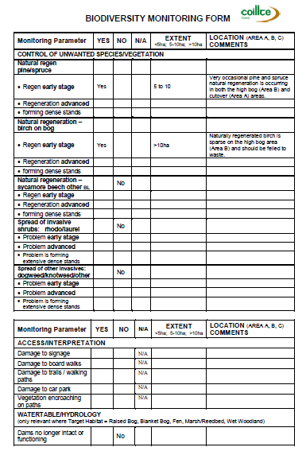
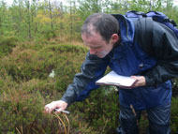
There is an After-LIFE
Monitoring
  Coillte Biodiversity Monitoring Form
  Resurvey of vegetation plots

Slide 19
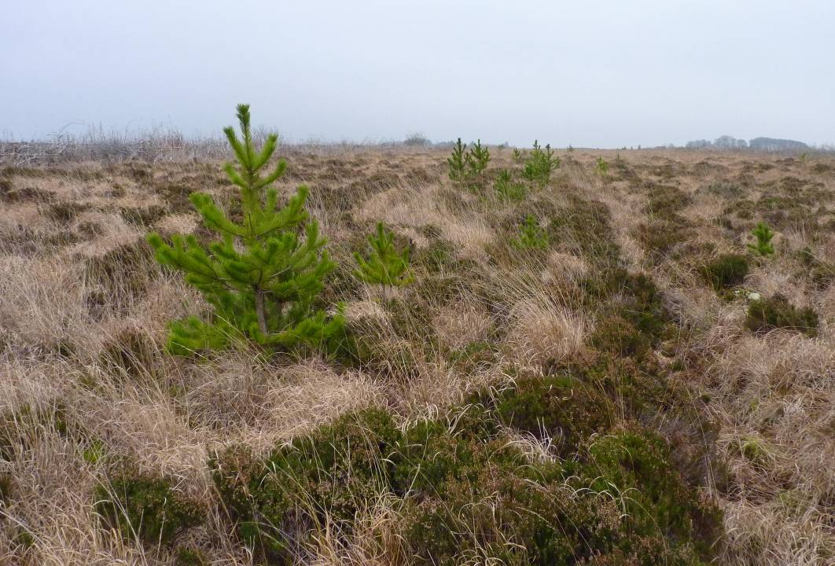
^{Monitoring – lessons learned}
Vegetation recovery good but the restored habitats will take a long time to mature
Some sites have ongoing management issues
Link to NPWS Raised Bog Monitoring Programme – most Coillte sites are “supporting habitat” – only small portions will become “active raised bog”

Slide 20
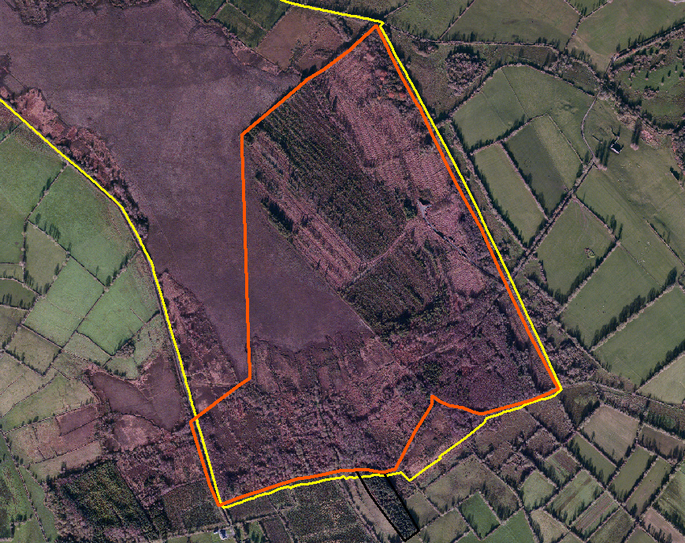
Mount Jessop Bog, Co. Longford

Slide 21
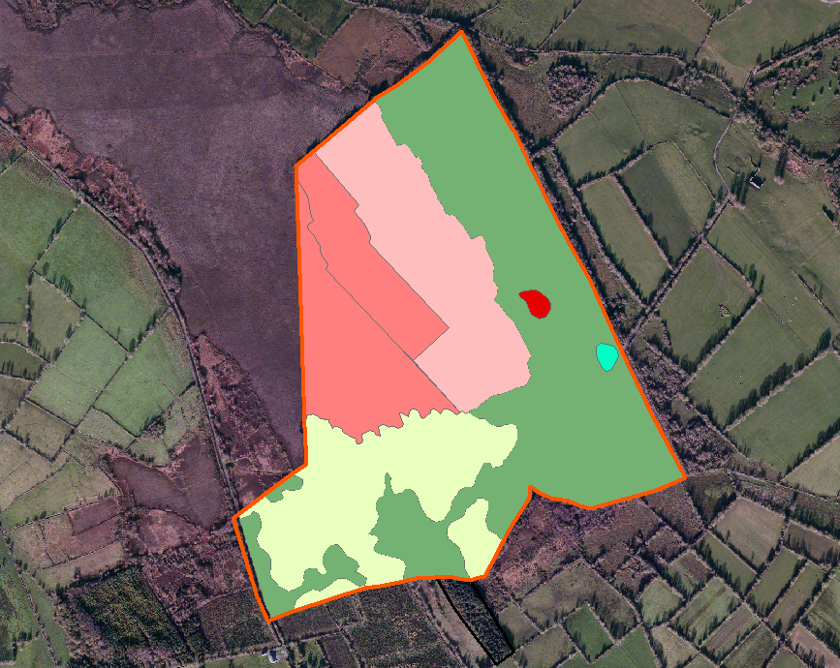
Mount Jessop Bog, Co. Longford – Target Habitats

Slide 22
The future?
EU LIFE – Rebuilding Ireland’s Natural Capital

Slide 23
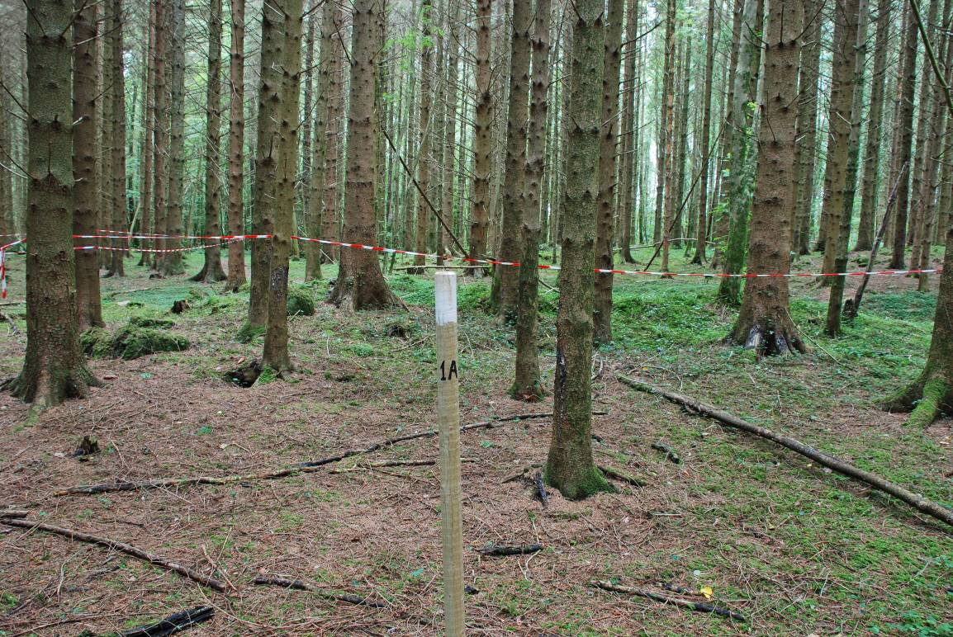
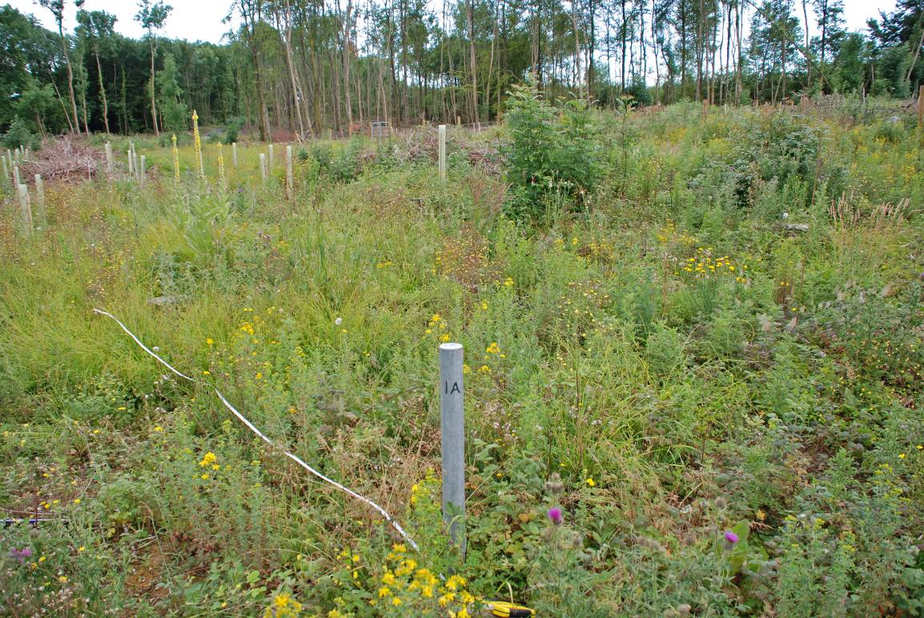
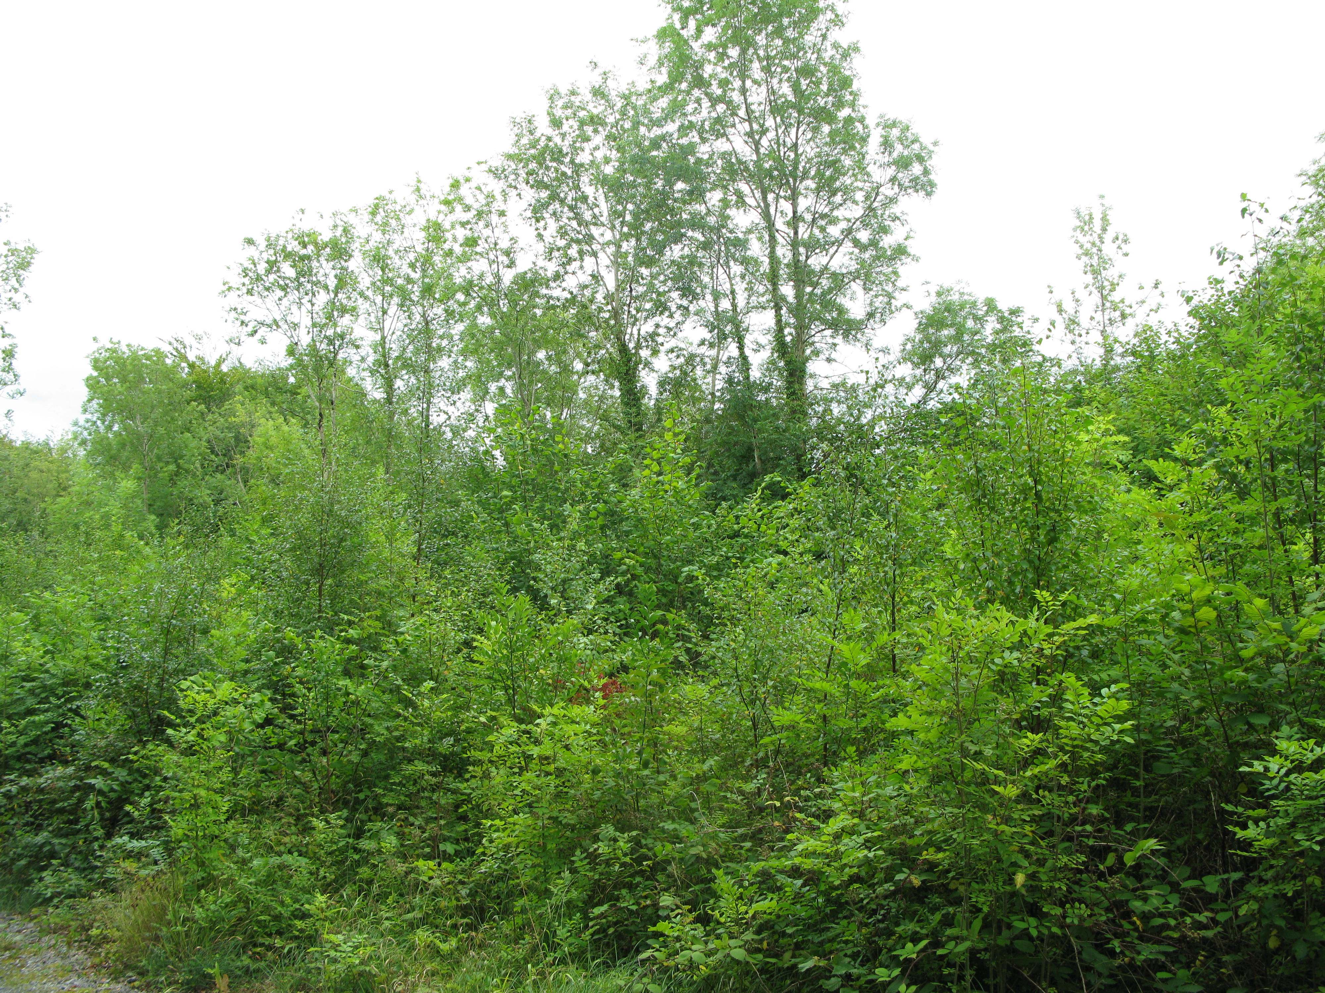
Attyslany 2007
2009
2015
Valuable natural capital
Young habitats with a bright future
Programme to attract appropriate funding

