Slide 1
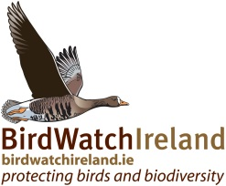
Conservation of Breeding Curlew in Ireland
Dr Anita Donaghy
Senior Conservation Officer, BirdWatch Ireland
Notes:
Hi, many thanks for inviting me along today. I’m a SCO with BWI, based in Donegal, where we have just completed a four year project on the conservation of Curlew and other breeding waders in the border region as part of an INTERREG IVA project. We learnt much about Curlew that is applicable nation wide and it is clear that it is one of our most threatened breeding birds, and one which is of very high conservation priority for BirdWatch Ireland. So in my talk I’m going to tell you a bit about the ecology of the species, it’s ecology, habitat preferences threats and declines and then I’ll describe the important role of BnM in the conservation of this species in Ireland.

Slide 2
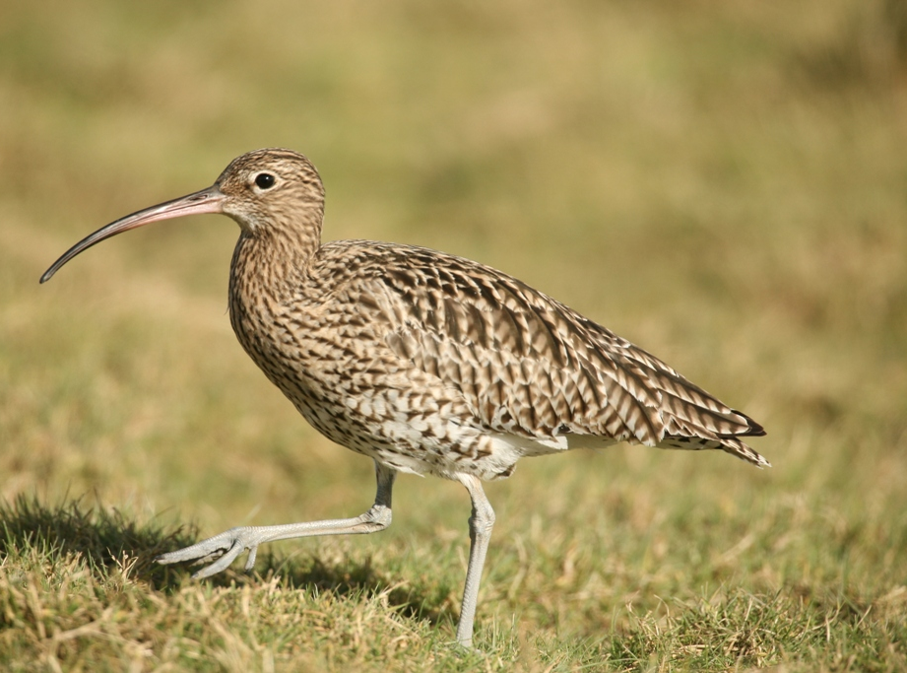
Eurasian Curlew Numenius arquata
Notes:
Largest wader in Western Palearctic, wing span of up to 1m. Long legs and long decurved bill Uniform grey brown plumage, but intricately marked. In flight the white V on the back can be seen.

Slide 3
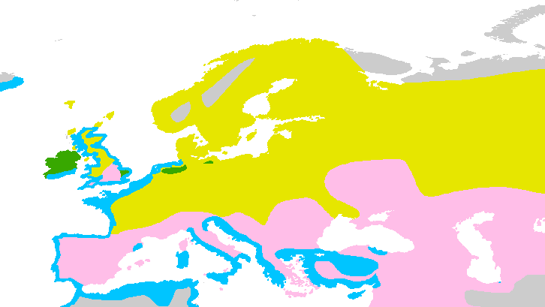
EUROPE – 75% OF GLOBAL POPN
82,000
68,000
22,000
100…?
Key: Resident, Breeding Season, Non-breeding Season, Passage
Notes:
In the 1980s, the global population was estimated at around 220,000 pairs, about 75% of which breed in NW Europe.
The species is mostly migratory, breeding inland in fields, moorlands and large forest clearings and wintering across Europe along coasts and estuaries where it gathers together in large flocks with other waders to feed, using it’s long bill to probe for soft mud for molluscs, shellfish and invertebrates.
Ireland is an exception with birds thought to be largely resident, wintering at wetland habitats around the coast and inland.

Slide 4
Autumn/winter passage
Notes:
In fact, large numbers of migrants come to Ireland in the winter to take advantage of the relatively mild conditions and large flocks can be seen around our coasts and larger wetlands all winter. This is why sometimes people find it hard to understand why in Ireland we are so concerned about the numbers. Of course most of these birds will leave our shores in March and return to their own breeding grounds, leaving just a very small remnant native Irish population.

Slide 5
Trends
↓ 22%
↓ 43%
↓ 78%
↓ 25%
↓ 70%
Notes:
We can see from this map that this species really is in trouble, with declines across it’s range, but nowhere more so than in Ireland, where we have lost almost 80% of the population. In the early 1980s, it was estimated that there were 5,000 pairs in Ireland, but the results of the recent Bird Atlas show that we have indeed lost a huge percentage

Slide 6
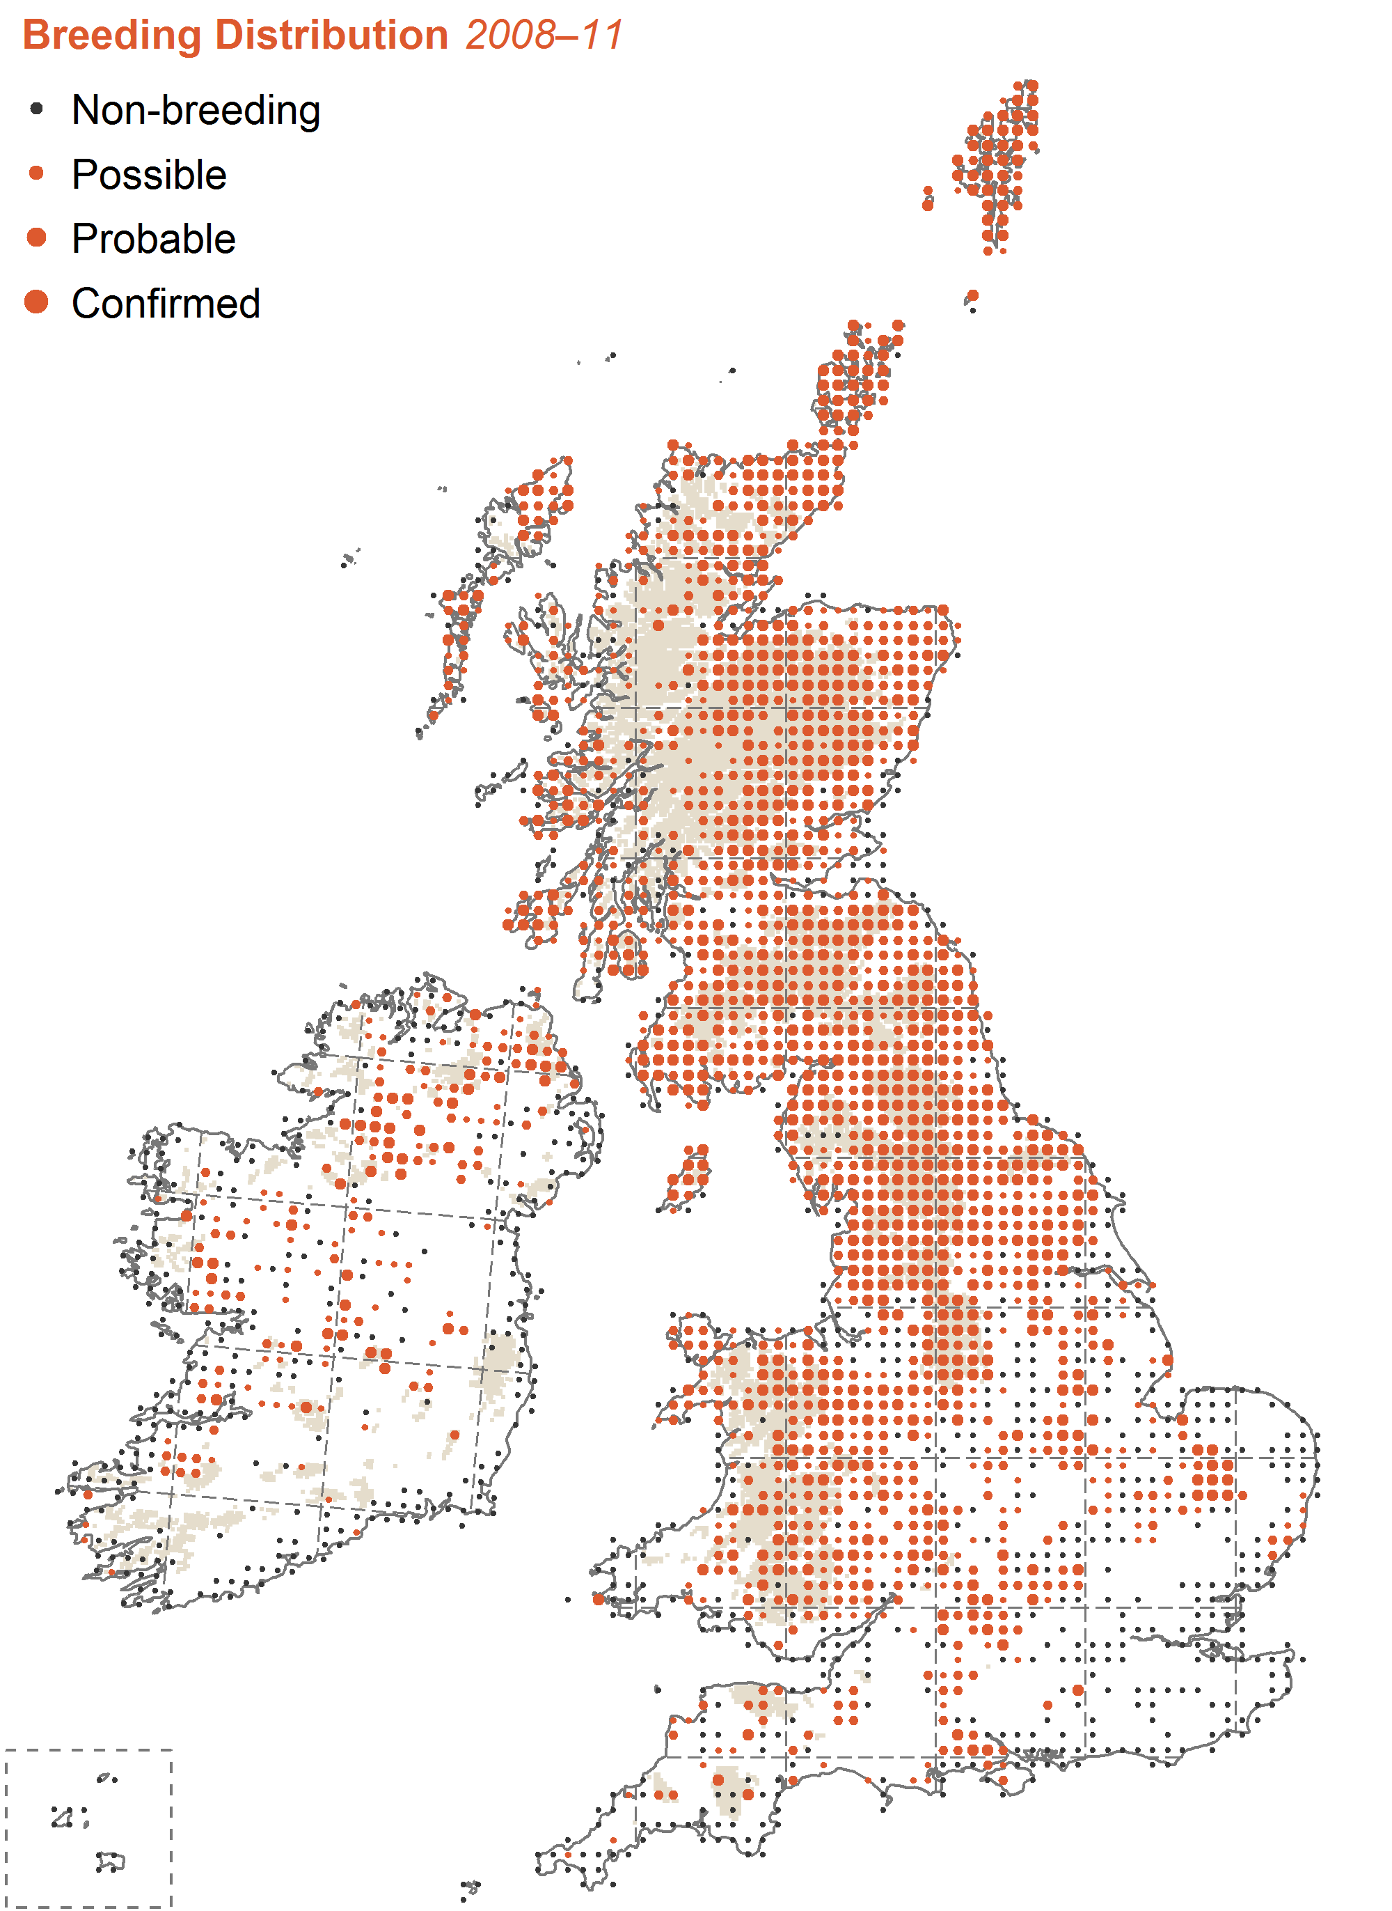
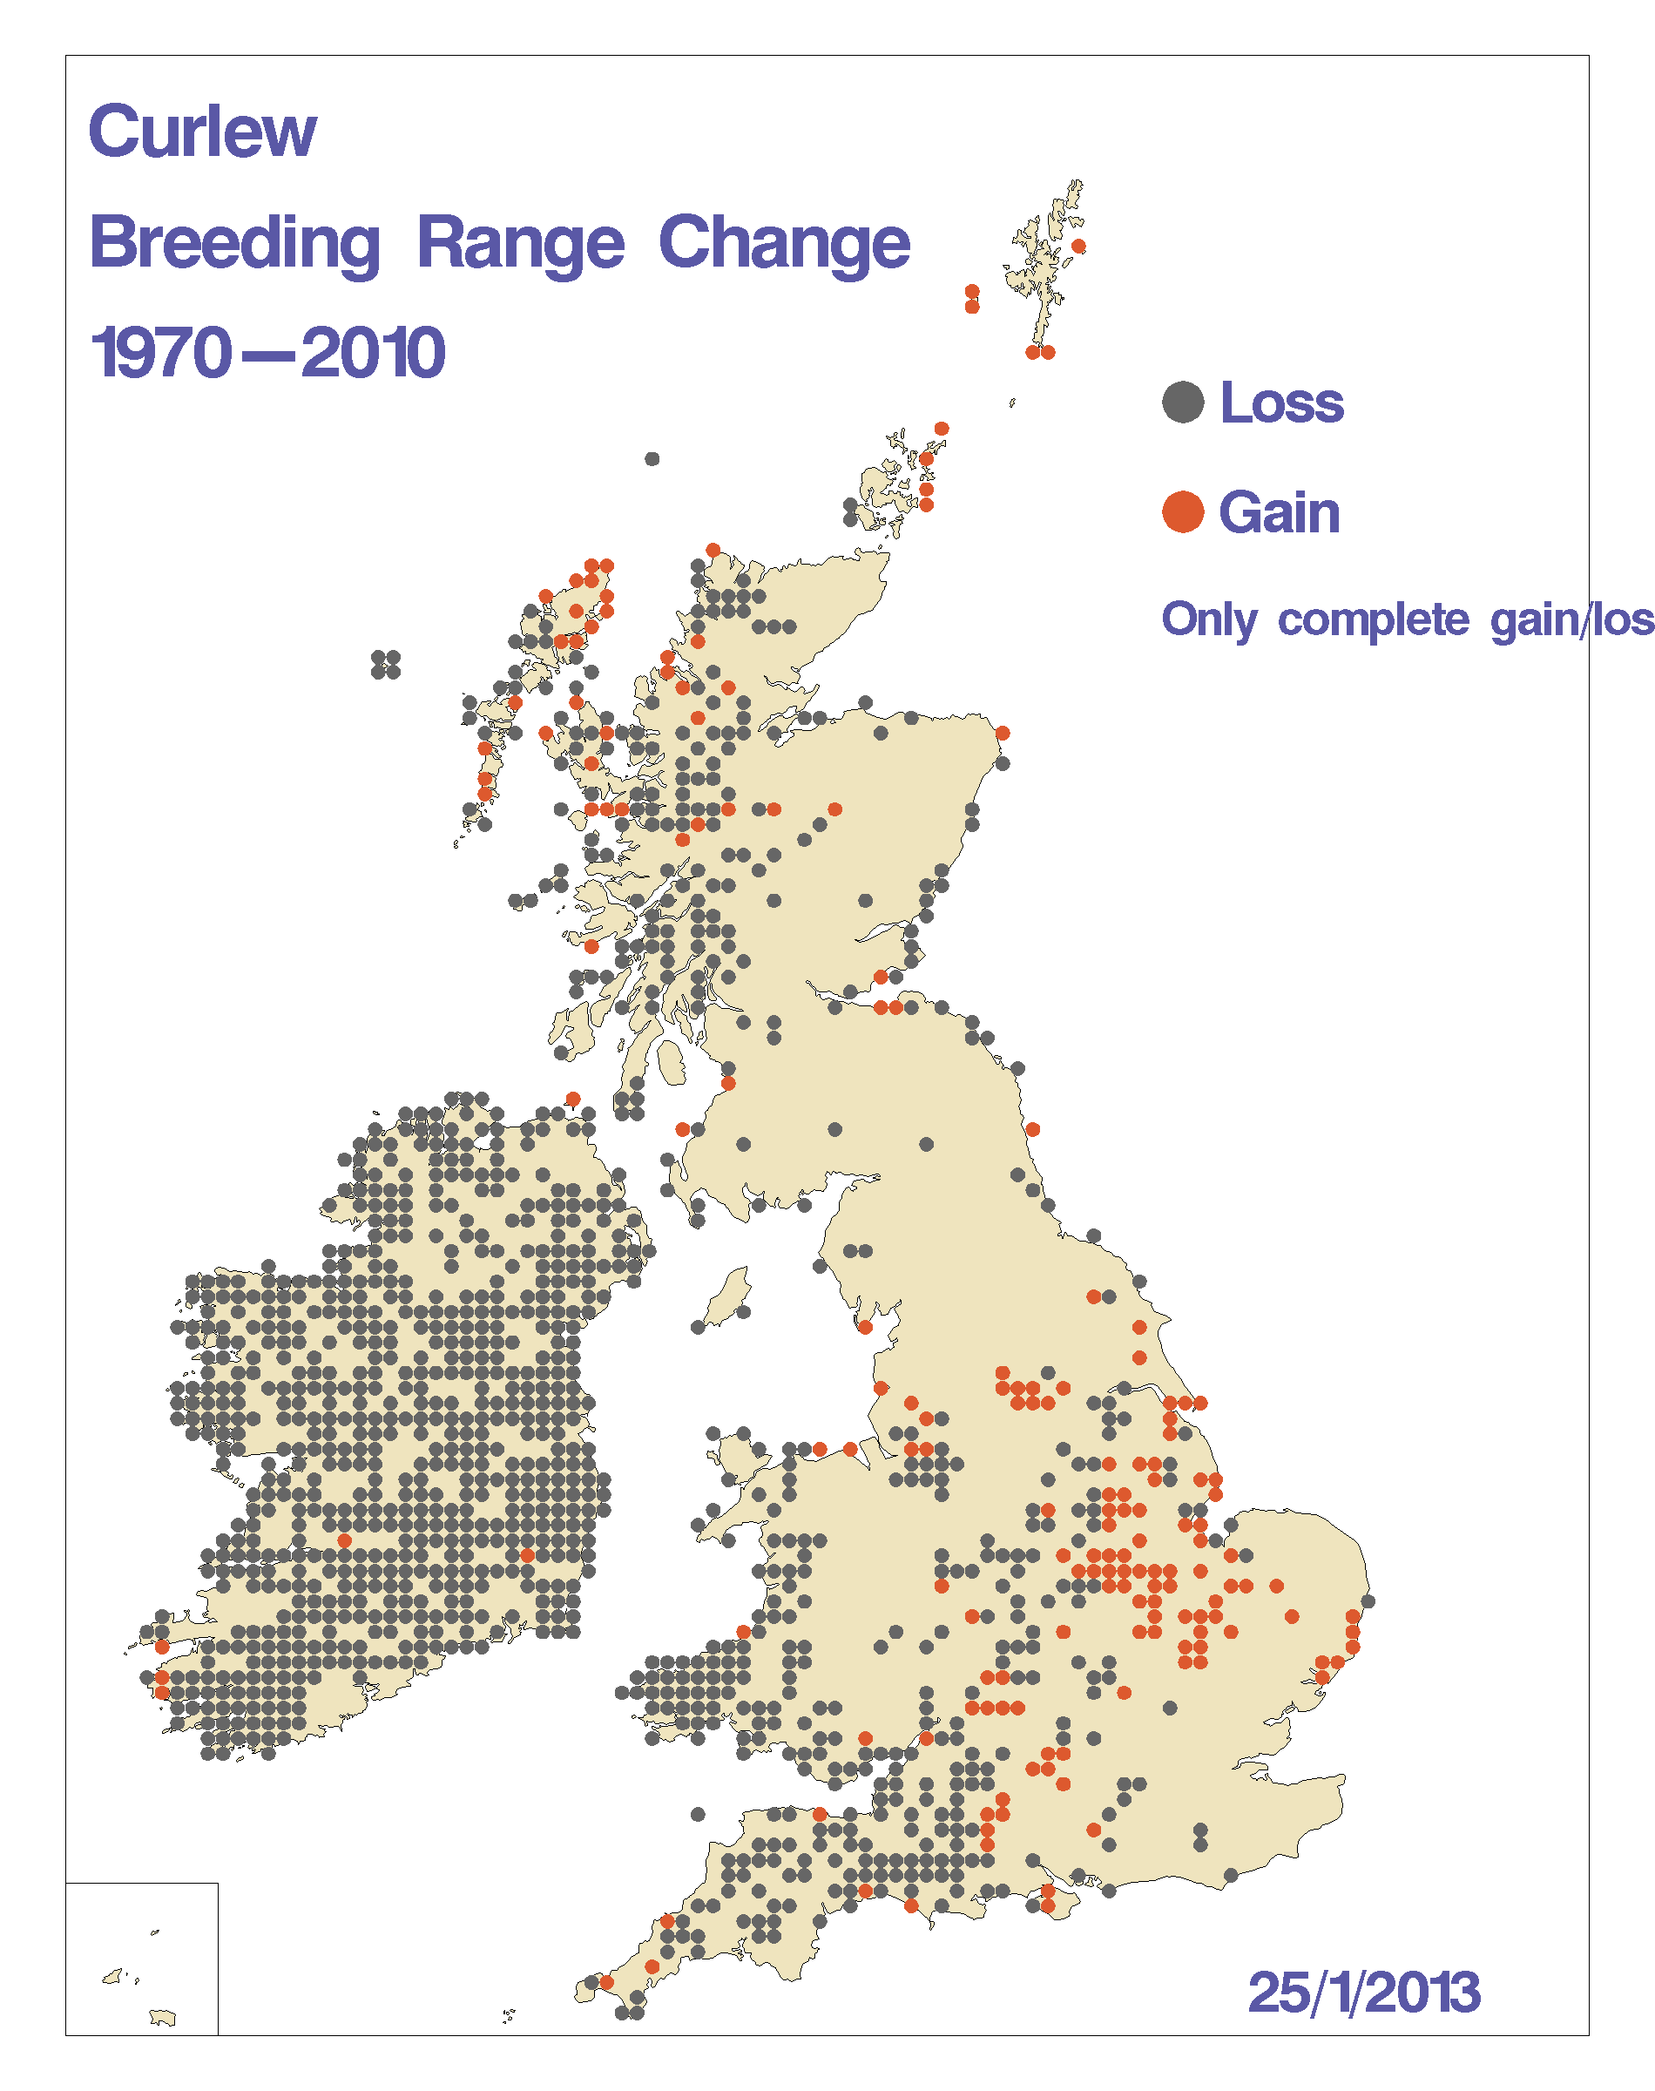
80% of range lost in 40 years
IUCN Red List - Near Threatened
Irish Red List
Notes:
The loss of breeding Curlews from most of Ireland and parts of western Britain over the last 40 years is a key finding from Bird Atlas . In Ireland losses have occurred mostly within the last 20 years.

Slide 7
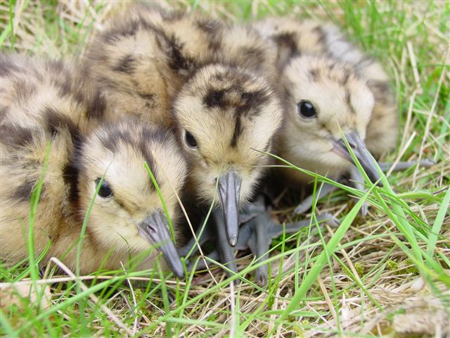
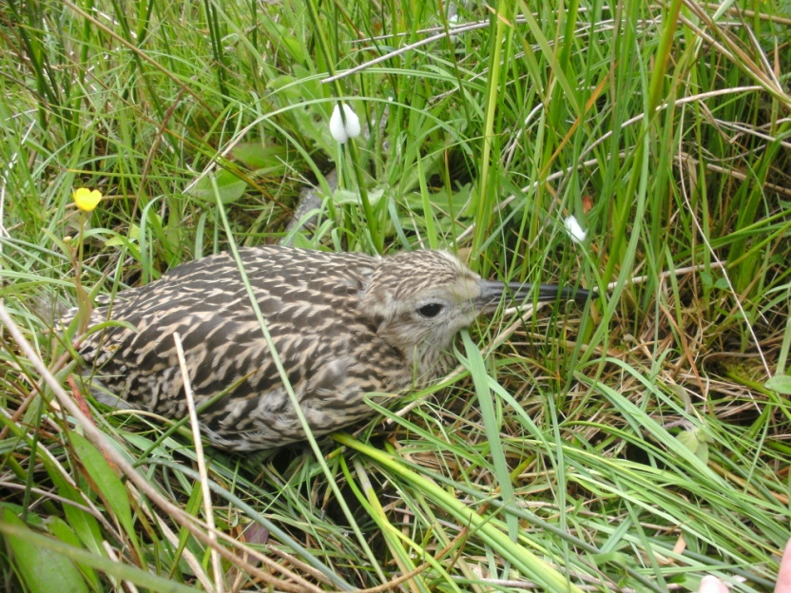
Curlew breeding season
April | May | June | July
Nests │ Chicks │ Fledglings

Slide 8
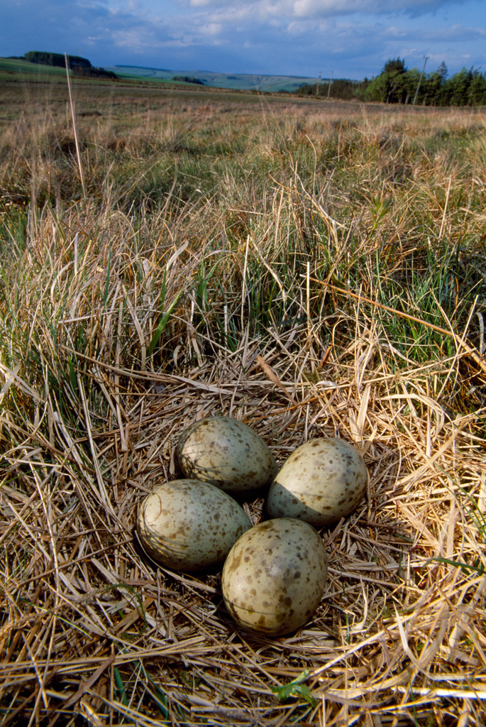
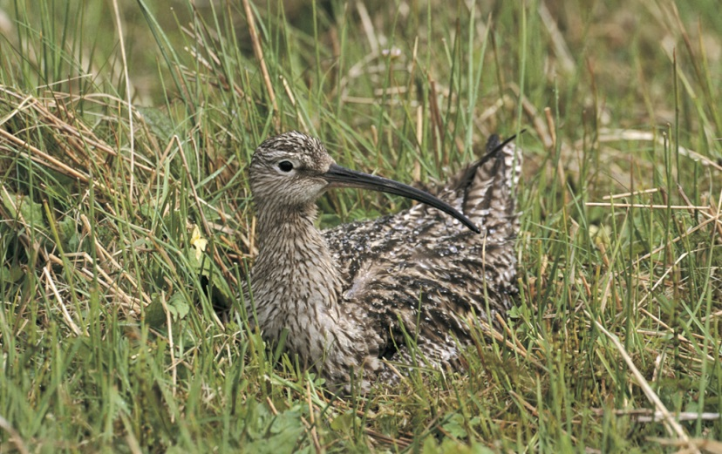
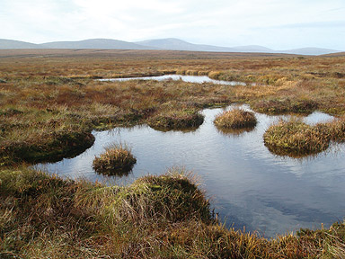
Habitat preferences
Curlew nest on the ground.
Prefer open landscapes.
Natural/semi natural vegetation.
Notes:
So what are the reasons for the severe declines across it’s range, and in particular in Ireland. To begin to understand that we need to look at it’s breeding ecology and habitat.

Slide 9
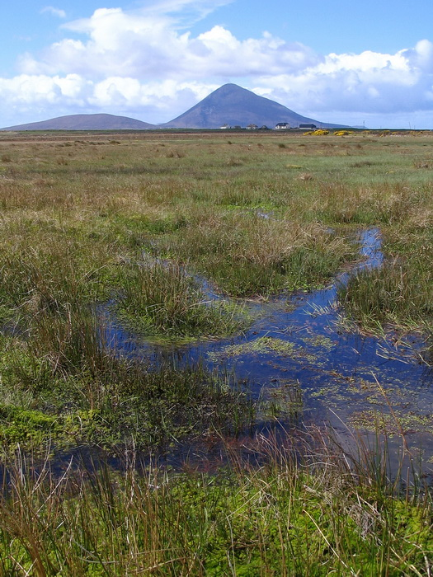
High water table
Soft mud for probing.
Shallow pools rich in invertebrates, important for chick feeding.

Slide 10
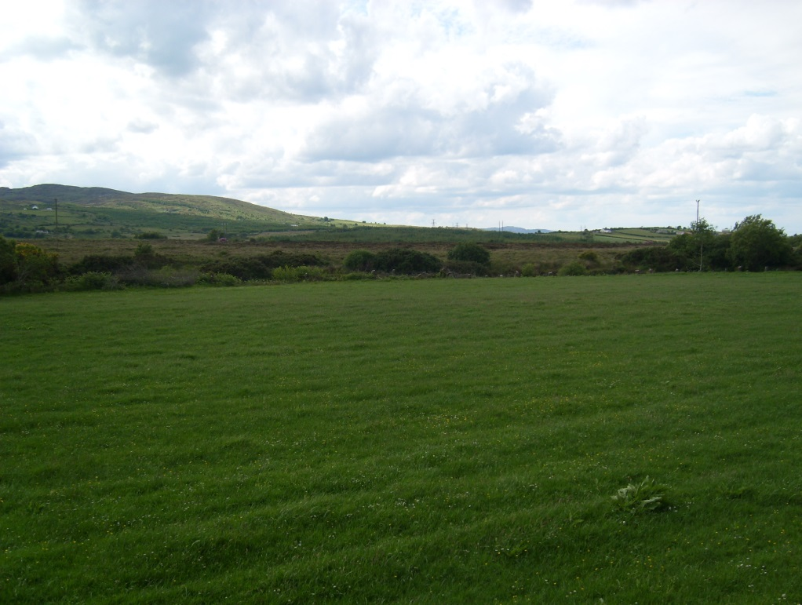
Why are the declines so severe?
Loss and fragmentation of Curlew breeding habitat.
Agricultural intensification of upland unimproved rushy pastures and lowland wet grasslands.

Slide 11
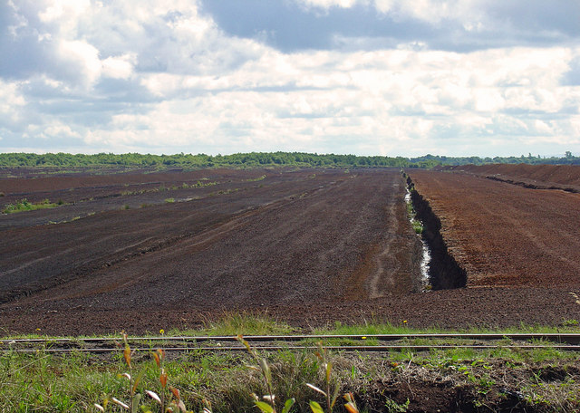
Loss and degredation of peatland habitats:-
-Industrial peat extraction
-Small scale peat extraction
Notes:
About 11% of Ireland’s land area now forested, about half of which is private forests established in the last 20 years, with around 7,000 ha of land planted annually; this has led to loss and fragmentation of many upland habitats, though there are now more restrictions on planting on unenclosed land and in upland SACs and SPAs, eg for Hen harrier.
Forestry, peat exploitation and ag intensification have led to severe fragmentation of habitats, in turn makes populations more vulnerable to predation.

Slide 12
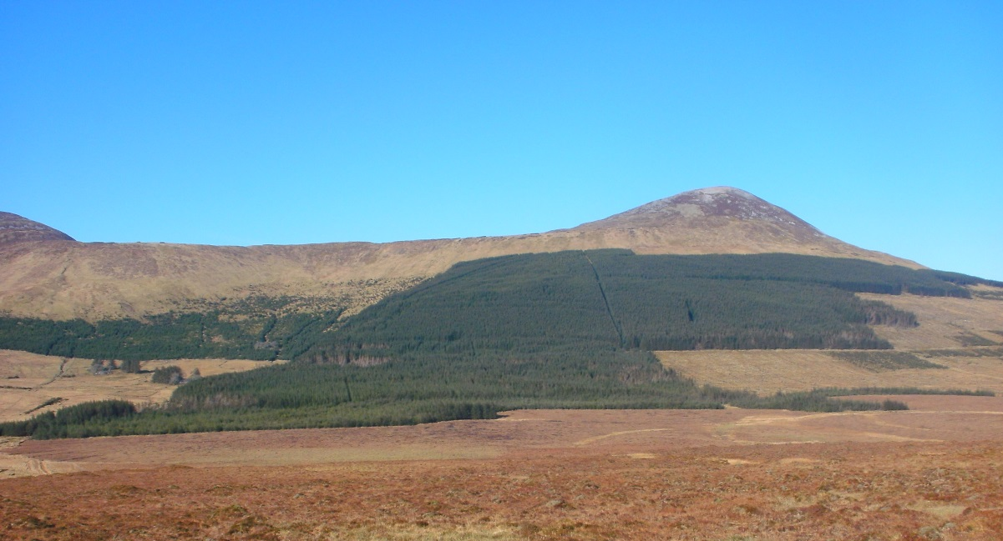
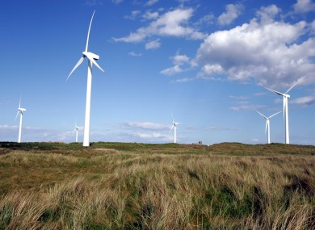

Slide 13
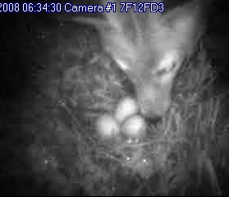
Subsequent predation
Studies in the UK and Ireland have shown unsustainable levels of predation of nests and young.
 | Nest predation | Chick predation
By mammals | 96 | 14
By birds | 4 | 68
Notes:
Studies funded by NPWS and by RSPB in NI

Slide 14
Current Survey work
2015 NPWS commissioned a 6 month survey of key breeding areas, following on from the Bird Atlas and work in 2014.
Main aim was to “more accurately define the locations of breeding Curlew, so as to target agri-environmental measures and other conservation actions that would secure the future [of known sites]”.

Slide 15
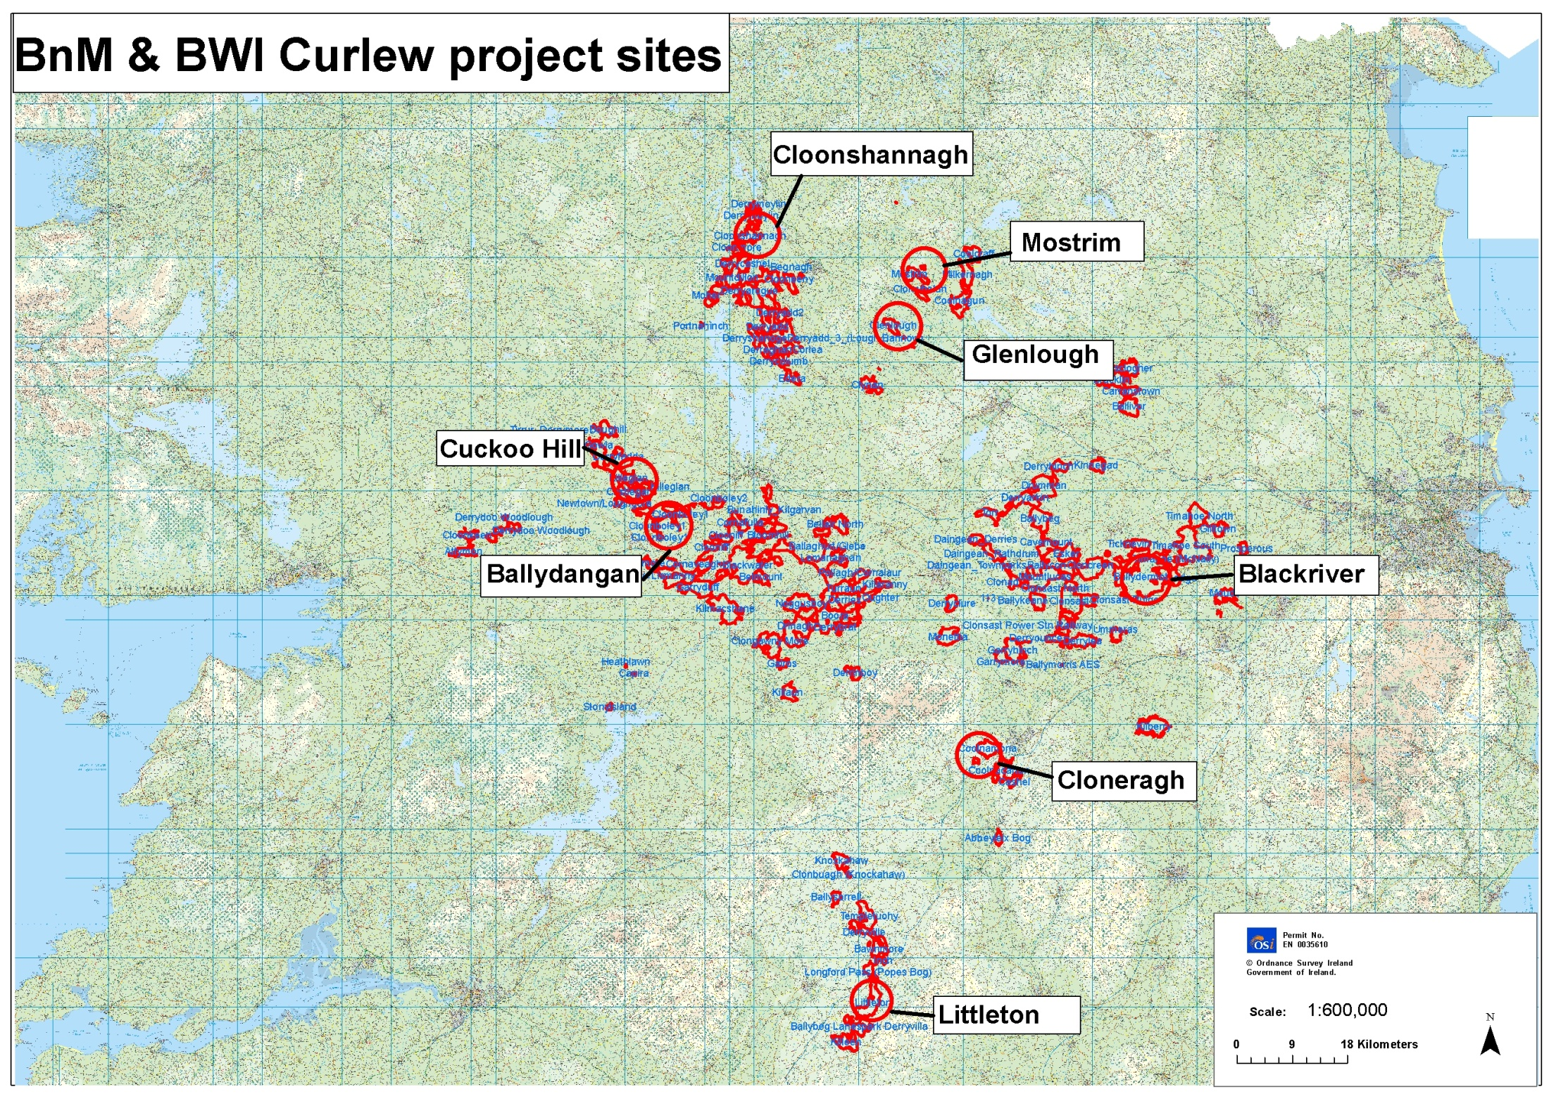
Bord na Móna – BWI Curlew Conservation Programme Phase I 2015
Survey Bord na Móna peatland sites.
Develop of management recommendations to enhance habitats for breeding Curlew.
Develop a methodology to identify other potentially suitable sites for breeding Curlew.
Notes:
Bord na Mona has already funded breeding bird surveys on cut away bogs. New phase to develop a CCP.

Slide 16
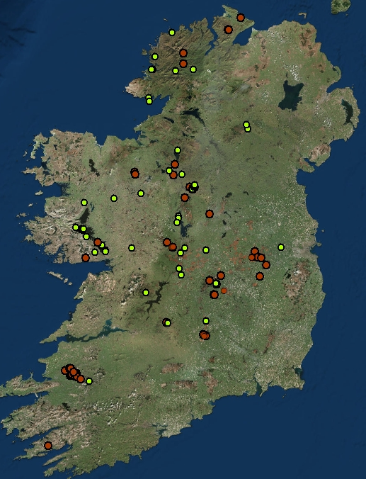
Current known distribution
 | Bog habitats | Other habitats | Total
No of pairs | 50 | 70 | 120
% of total | 41 | 59

Slide 17
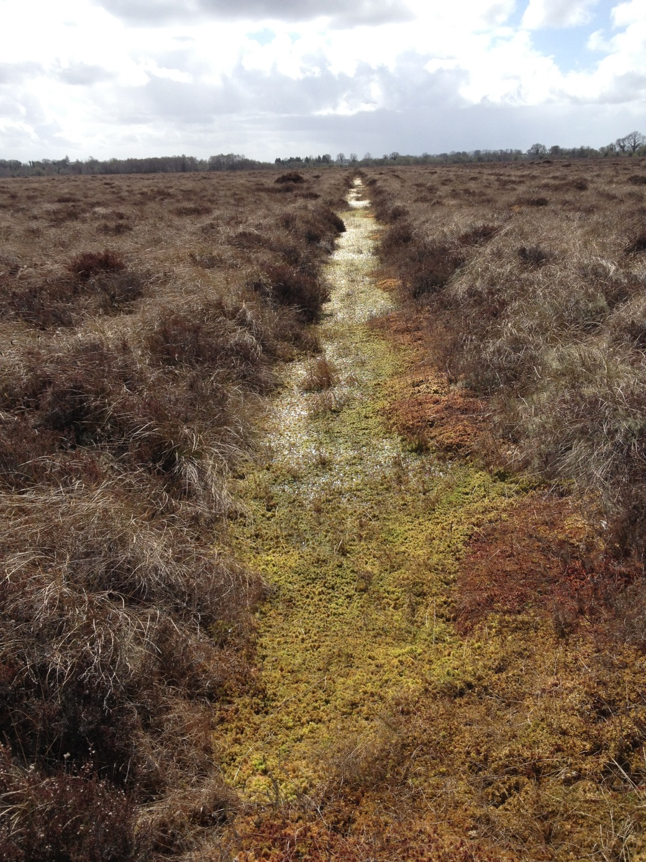
Bogs as Curlew habitat
Bogs are a crucially important habitat for the remaining Curlew population.
Used as nesting areas.
Birds nesting on nearby farmland will use bog habitats for feeding and chick rearing.
“Peatland habitats may increasingly become important refuges in areas where farmland no longer provides suitable breeding habitat.” AEWA INTERNATIONAL SINGLE SPECIES ACTION PLAN FOR THE CONSERVATION OF THE EURASIAN CURLEW
Notes:
Bogs are a crucially important habitat for the remaining Curlew population.
Almost one third of pairs nest on bogs.

Slide 18
Bogs can be degraded as breeding habitat for Curlew by activities such as drainage, unregulated peat extraction, overgrazing and burning.
Areas, such as those owned by Bord na Móna, Coillte or Forest Service, where these activities can be controlled or prevented are extremely important.
BnM Curlew project aims to protect and manage their landholdings where Curlew are breeding.

Slide 19
Coillte Life Project
Intact bogs provide the best Curlew habitat and Preservation of sites which have not been modified most important measure.
However, cutaways, remnant raised bogs and restoration sites can also provide good habitat.
-Removal of trees from sites which have not dried out to restore open bog habitat.
-Ditch blocking to raise water levels.
-Prevention of over grazing.
-Control of scrub/new tree establishment
-Bird surveys for important species

Slide 20
More measures needed
Peatland sites with breeding Curlew still being lost:- -unregulated extraction -Forestry -Wind farm developements

Slide 21
Bird Sensitivity Mapping for Wind Energy
A means to achieving our renewable energy targets without adversely impacting on our obligations to the Birds and Habitats directives
Uses existing data and stakeholder involvement to identify sensitive areas for certain key species.
Notes:
Sparrow hawk

Slide 22
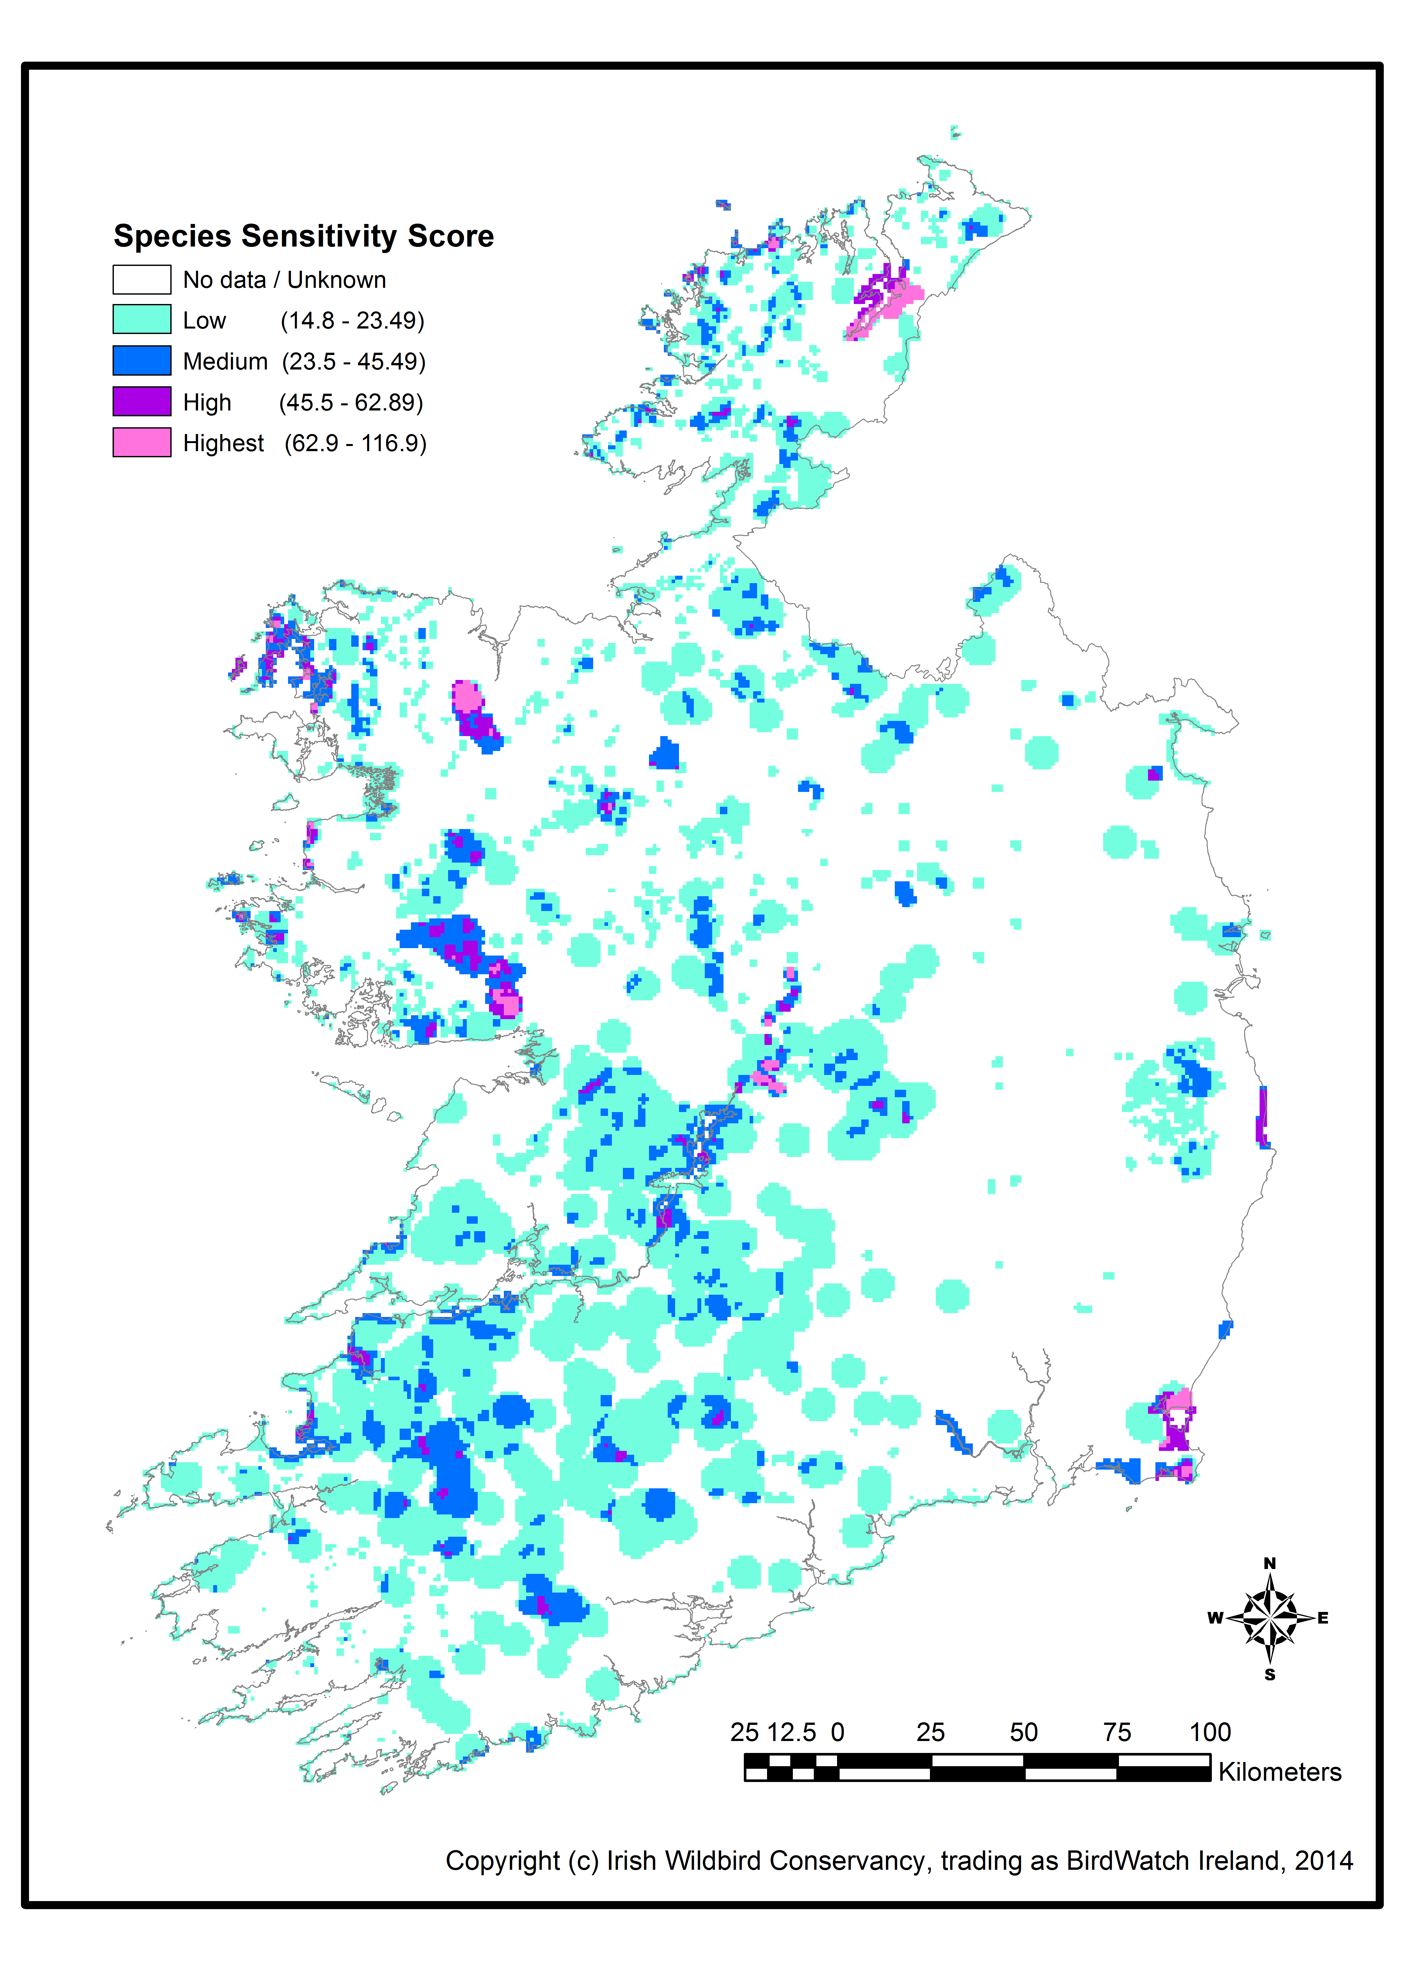
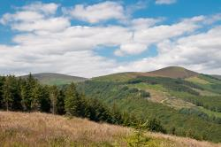
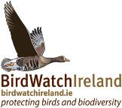
Next steps
Forestry
Scoping for Bird Sensitivity Map for Forestry - a tool and guidance for strategic planning of future forestry in Ireland with reference to priority birds

Slide 23
Measures for Curlew on farmland
GLAS Breeding Wader option targets Shannon Callows.
GLAS Tranche 2 will offer a specific option for Breeding Curlew.
Results of 2015 survey will feed directly into this measure.
Results Based Agri-Environment Payments Scheme (RBAPS) trial measure for breeding waders on Shannon Callows 2016-17.

Slide 24
Threat Response Plan needed
More survey work to identify breeding areas.
Monitoring of population.
Roll out of Curlew measure in GLAS
More protection especially for known nesting areas on peatland sites.

Slide 25
THANK YOU

