Slide 1
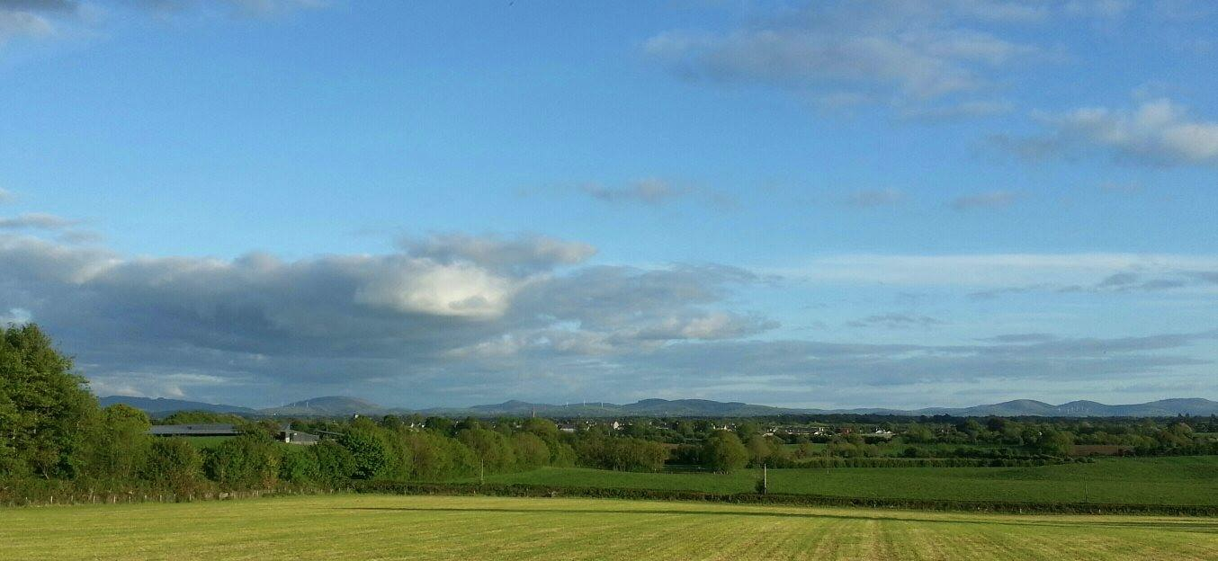
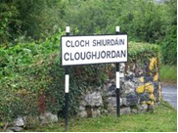
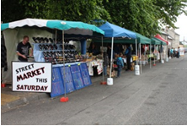
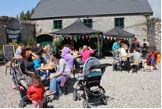
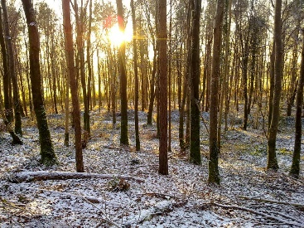
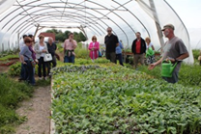
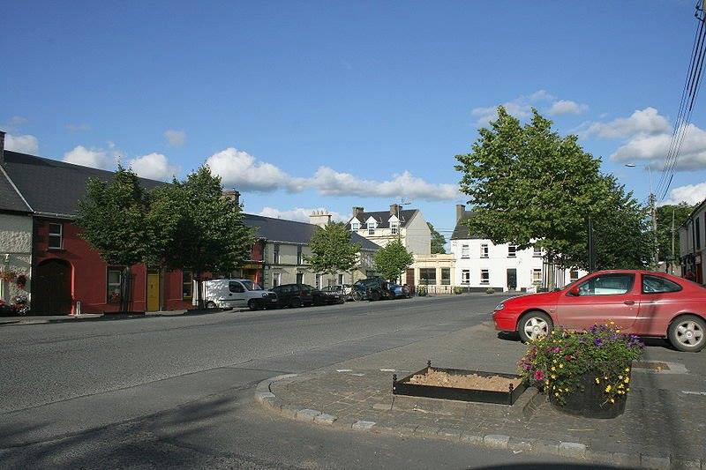

Slide 2
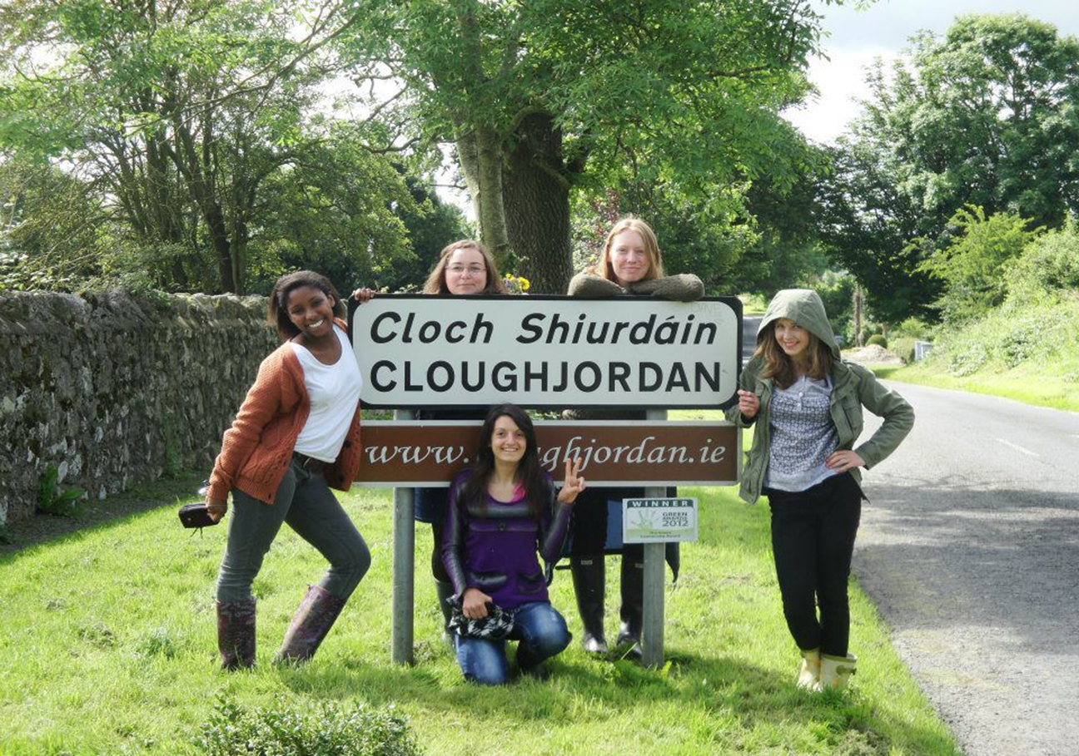
The Cloughjordan Community Development Committee is a registered charity and the umbrella grouping for a number of local voluntary groups.
Heritage Group
Tidy Towns Group
Walks Group
Crèche Group
Business Development Network
Cloughjordan Festival
Street Market
Playground Group

Slide 3
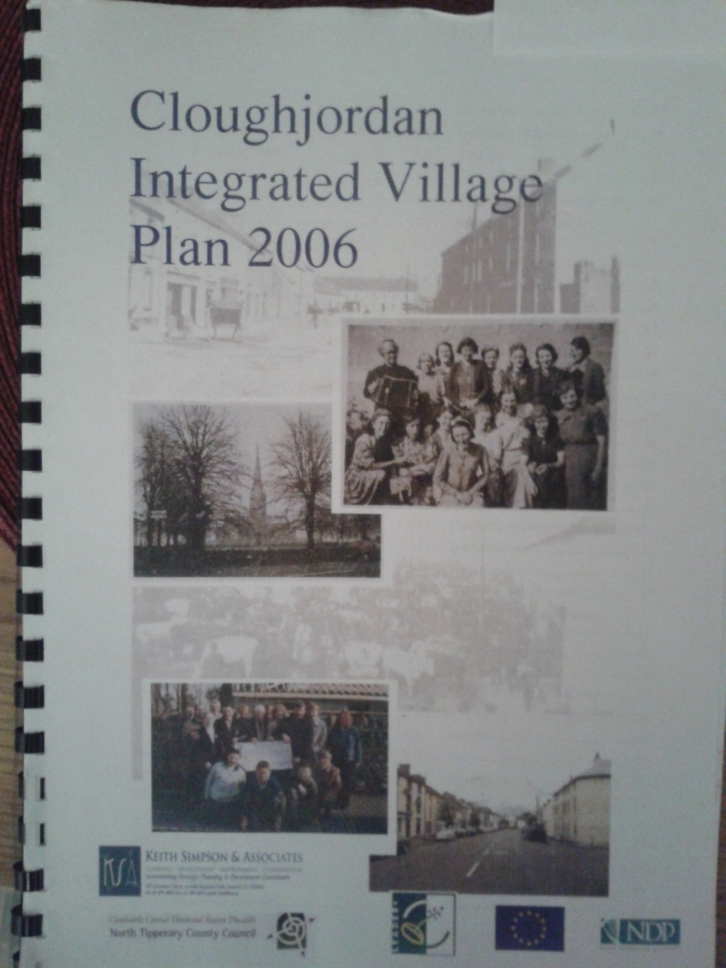
Cloughjordan – a CLÀR area.
Cloughjordan Integrated Village Plan
Issues identified:
lack of childcare facilities in Cloughjordan.
lack of amenities such as recreational walks.
lack of pride of place and poor involvement in Tidy Towns.
a greater emphasis on heritage.
a regular street market.
an annual festival.

Slide 4
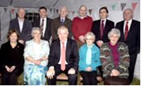
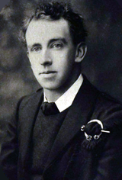
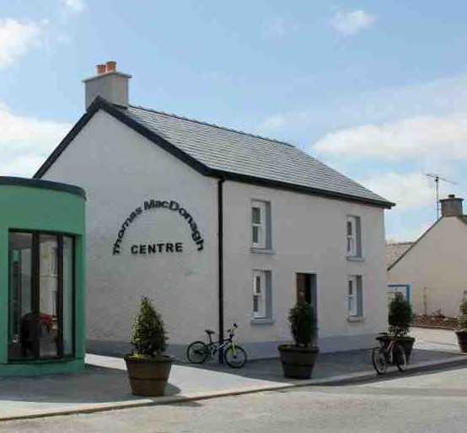
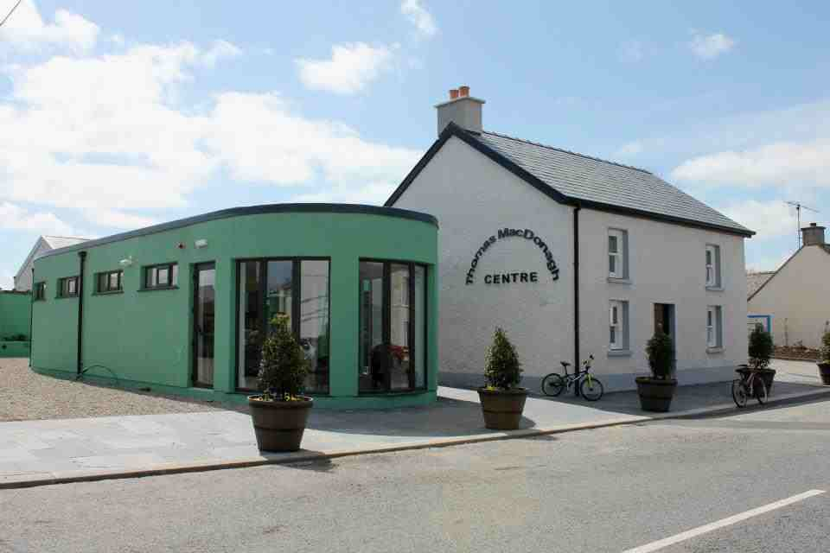
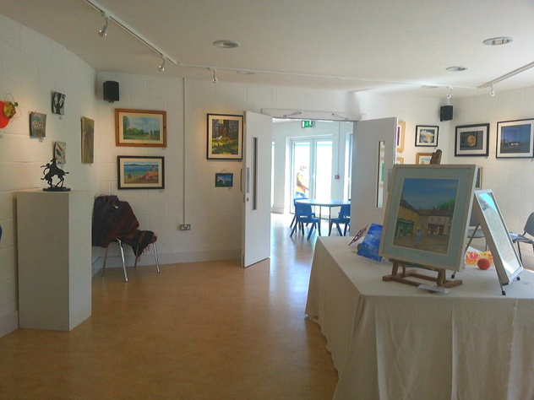
Cloughjordan Heritage Group :
Opened in May 2013
Hosts public exhibitions.
Used by Cloughjordan CineClub for film showings.
A space for meetings and public talks.
In National Museum Standards Accreditation Programme

Slide 5
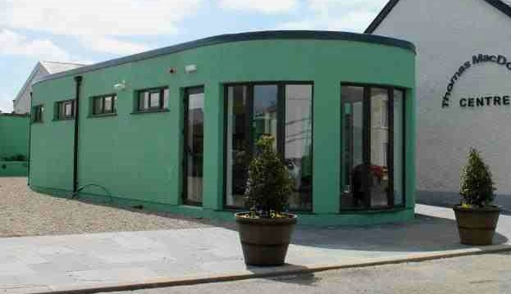
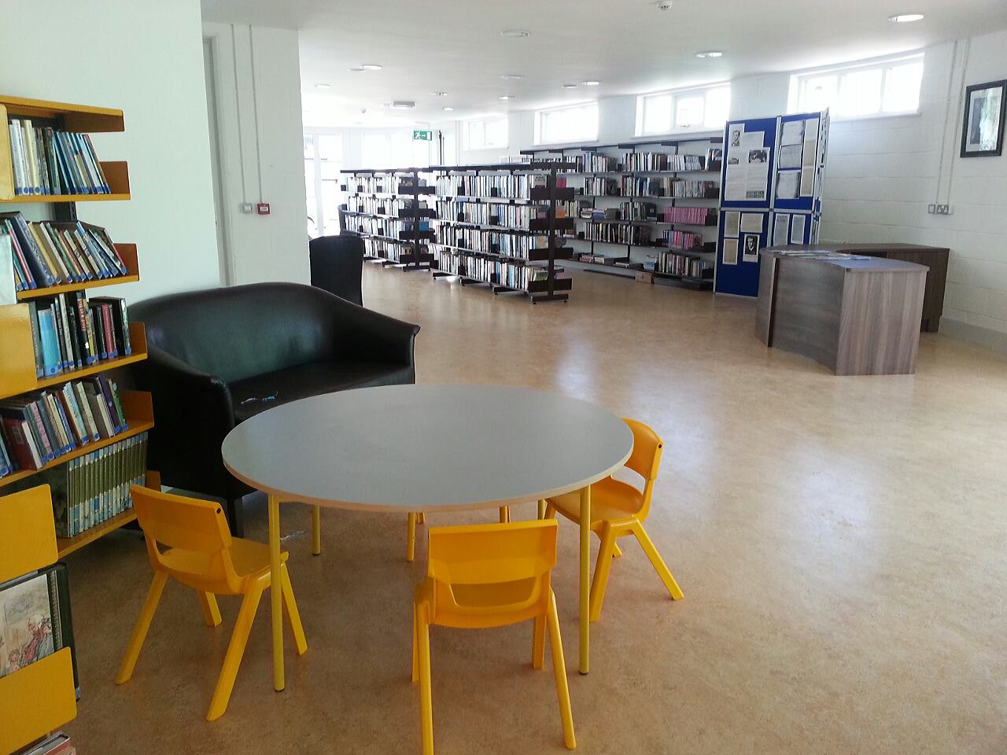
Cloughjordan Public Library (Opened May 2013)
Part of Tipperary Library Services
Serves the wider community
Links into local schools programmes

Slide 6
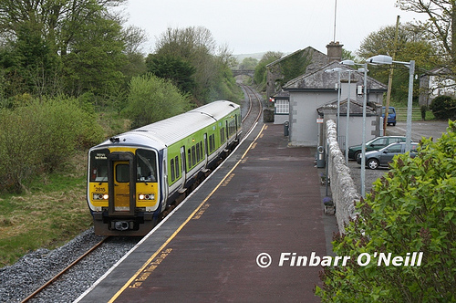
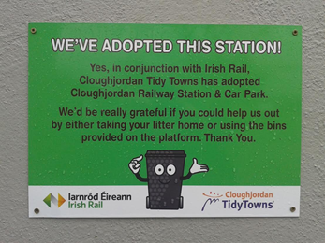
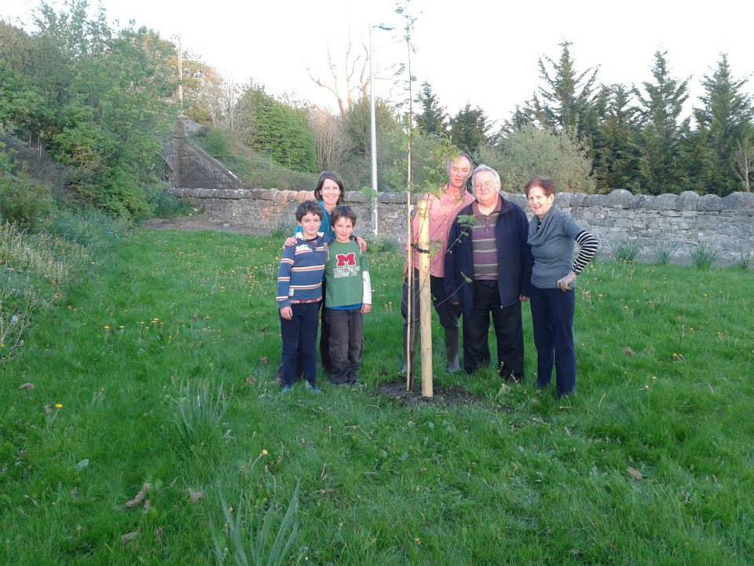
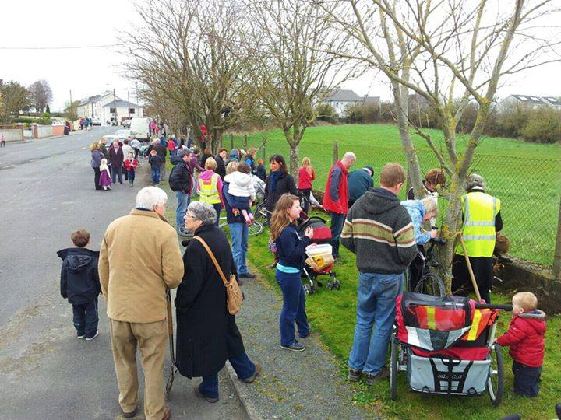
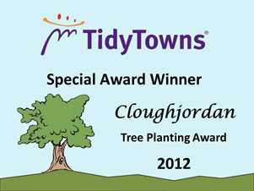
Cloughjordan
`Street Clean`events
Adopted Railway Station
Community planting events
National Competition, Special Award Winners in :2011, 2012, 2014

Slide 7
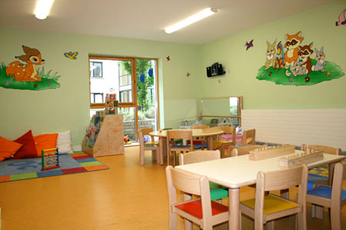
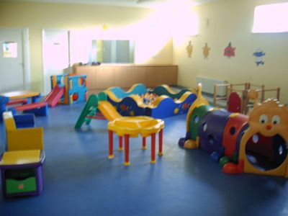
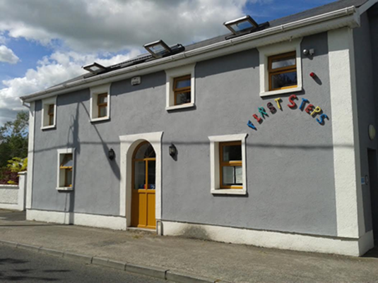
Crèche Group - Community Crèche
Catering for children aged 12 months to 12 years.
Currently caters for 90 Children
Employs 9 staff

Slide 8
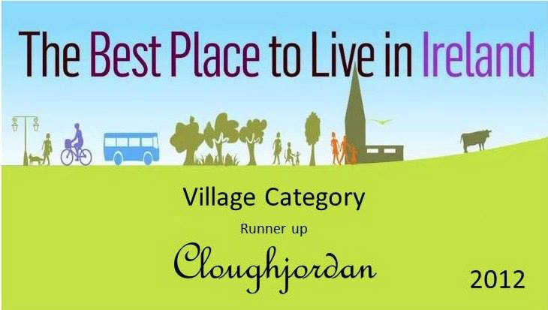
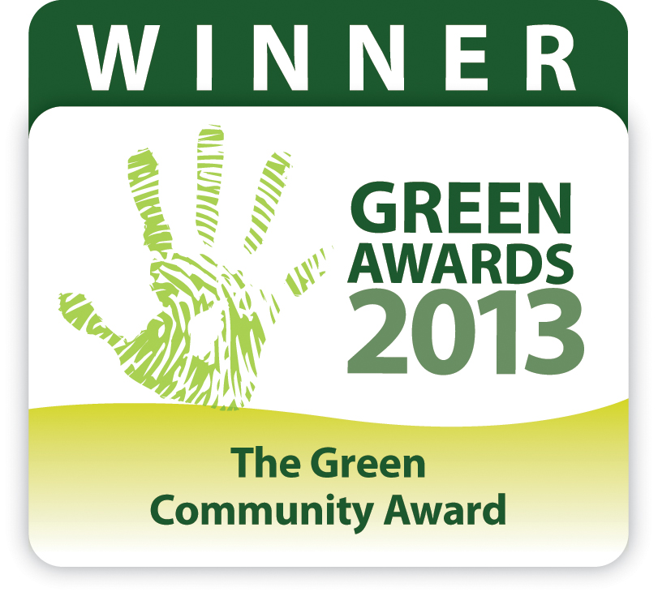
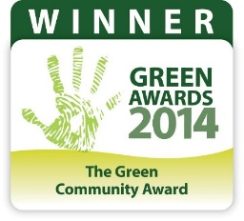
Cloughjordan- An Award Winning Village Today!

Slide 9
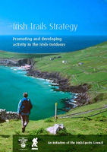
Recreational Trail Development
Local interest
Local health

Slide 10
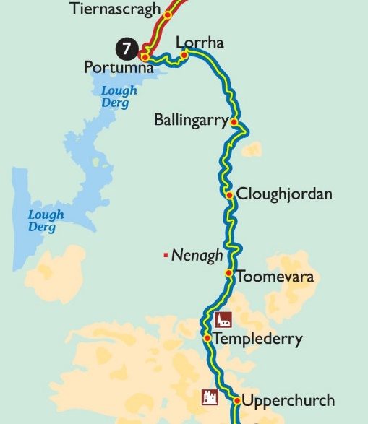
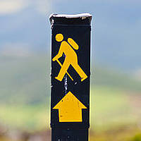
Walks Group : Beara-Breifne National Waymarked Trail.
…500 km Walking & Cycling route following the historic march of O’Sullivan Beara in 1602
Cloughjordan section will link main street with Knockanacree and Sopwell Woodlands.
Cloughjordan well placed to be an accommodation stopping point.

Slide 11
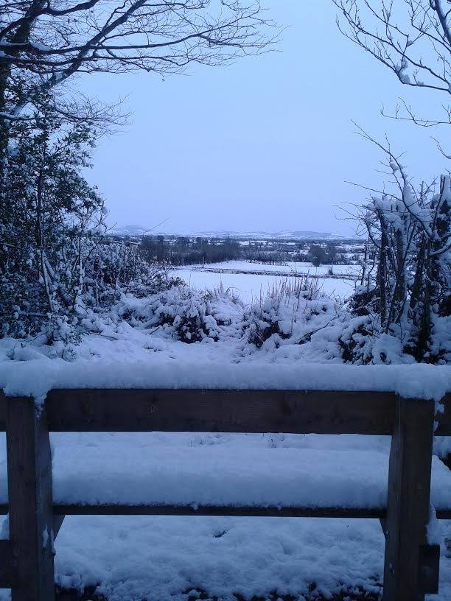
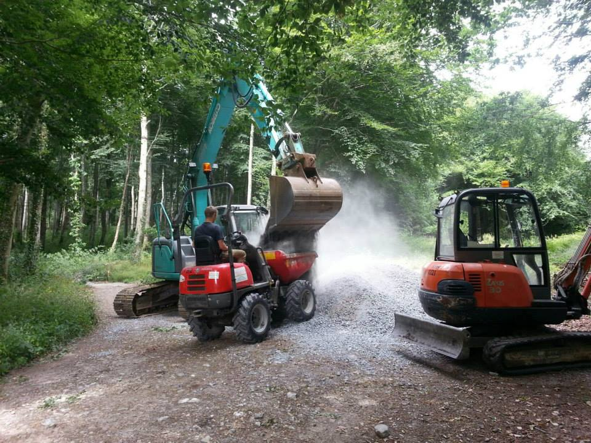
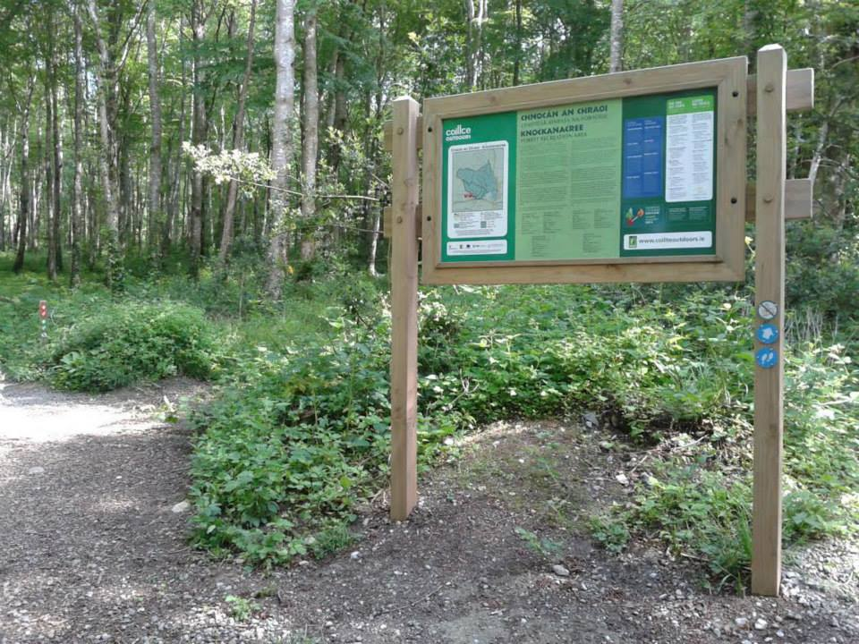
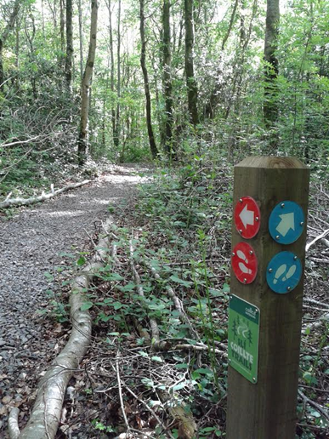
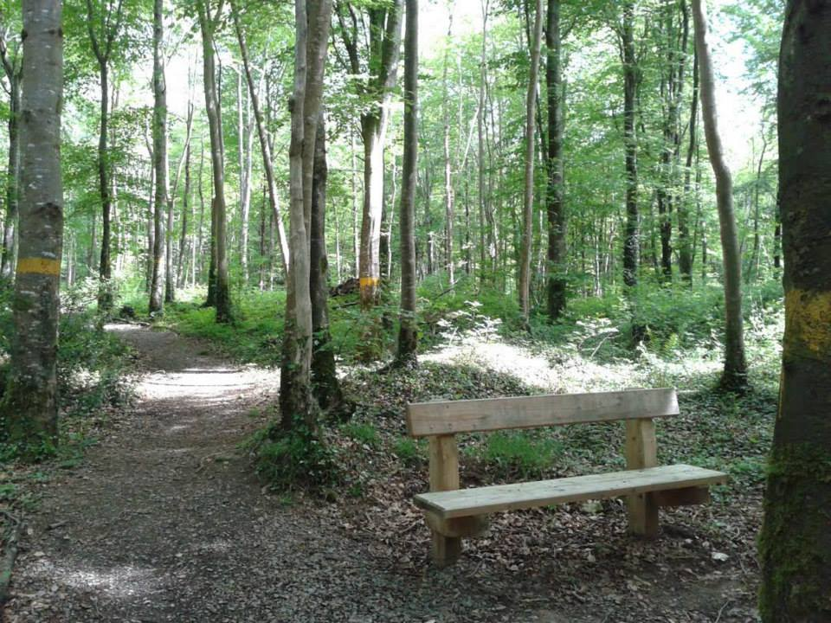
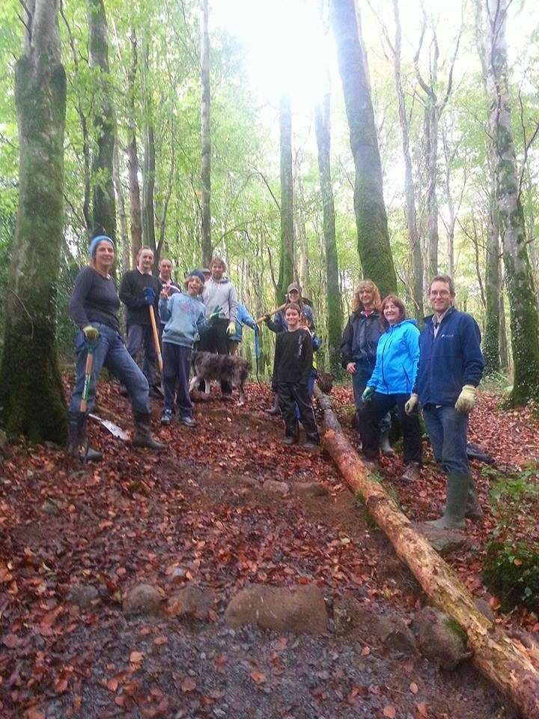
Walks Group : Knockanacree Community Woodlands Project.
3 Looped Walking Trails
Funded through NTLP & Local Contribution.
Example of partnership between State Agency & Local Community
2014 RDS Irish Forestry Awards.
Runners Up & Special Merit Award Winners in Community Woodlands Category.
Volunteerism

Slide 12
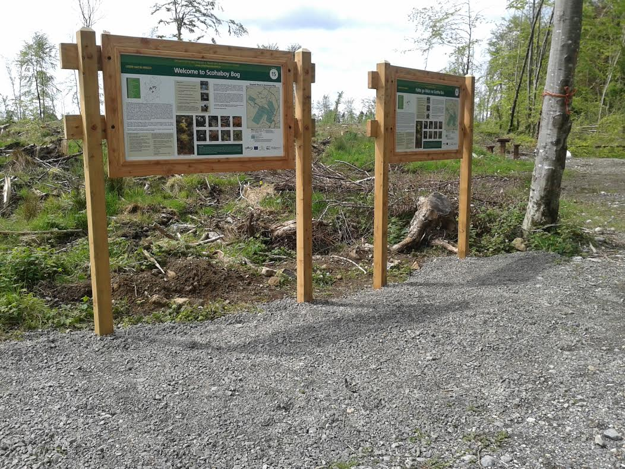
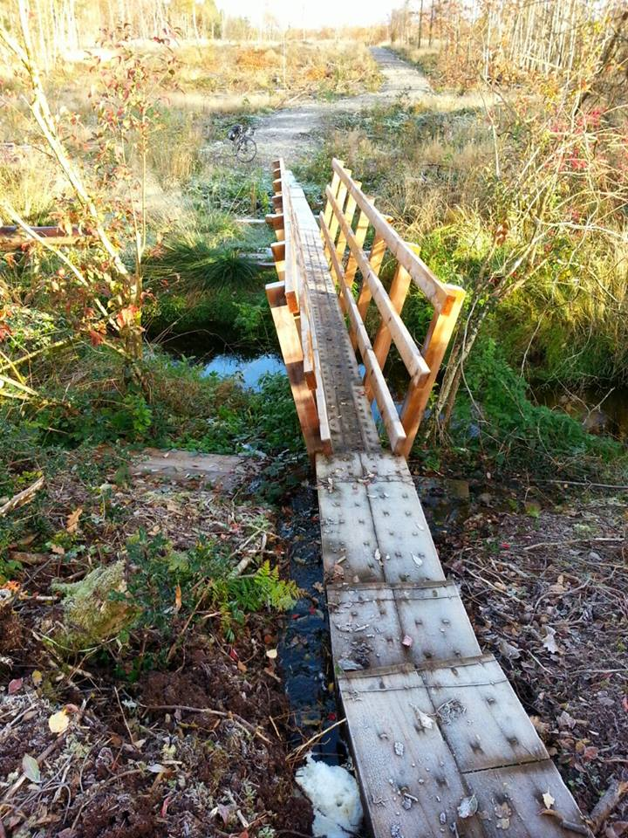
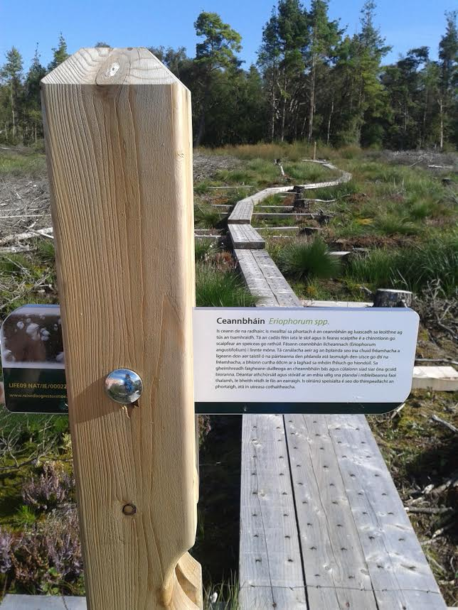
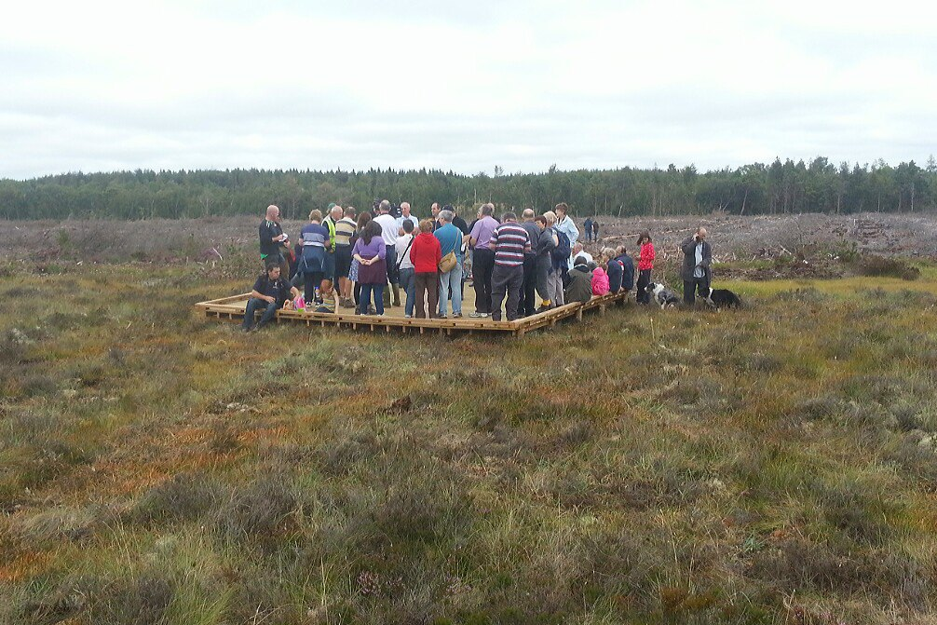
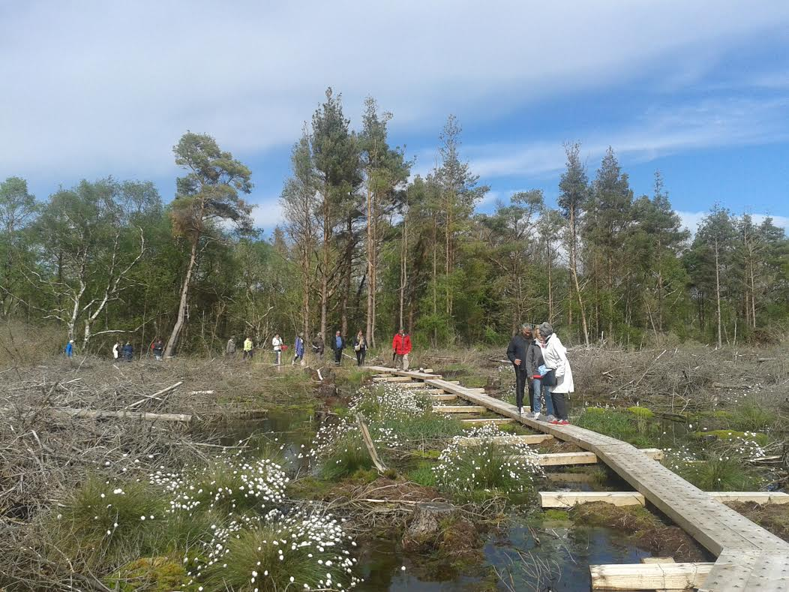
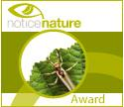
Walks Group : EU/LIFE Scohaboy Raised Bog Restoration project (National Demonstration Site)
Winner :
2014 Notice Nature National Biodiversity Award
A Local Asset – connecting Sopwell Woodlands & Scohaboy Bog
Visitors on `Bog Bridge`

Slide 13
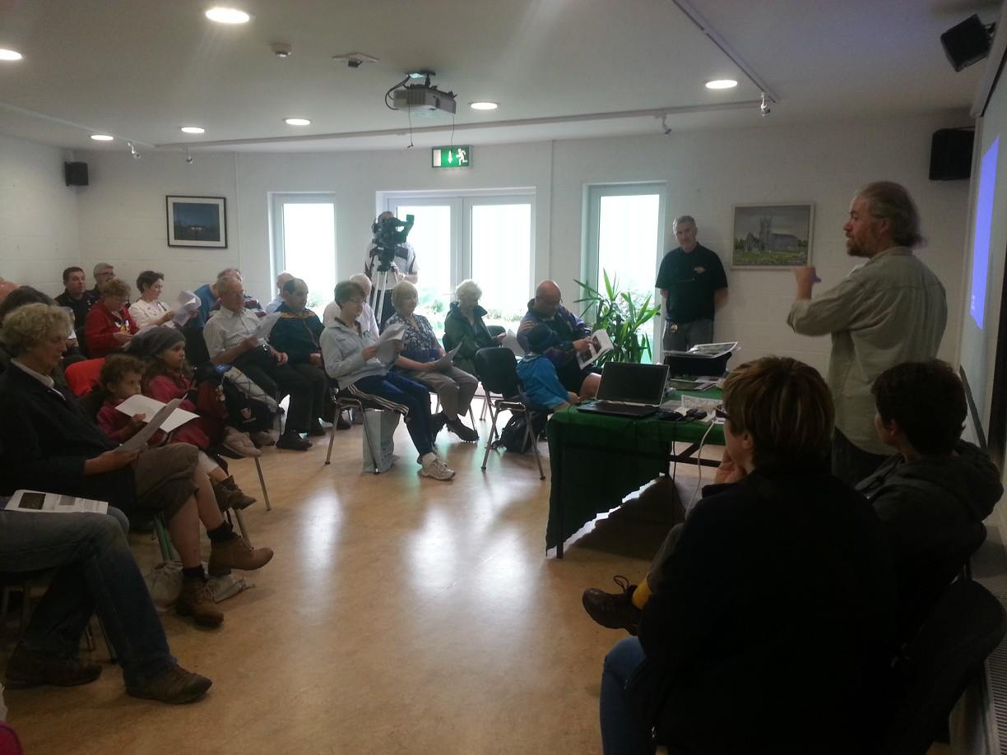
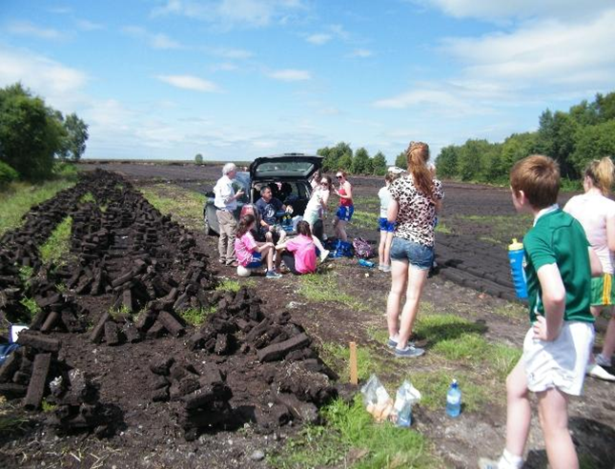
`the air on the bog is like the air by the sea`.
Community Engagement :
Dec. 2011 – Public Consultation Meeting, hosted by CCDC & Heritage Group.
A representative gathering…MC for evening local councillor.
Presentation on place of Scohaboy in local traditions and culture……
Memories of those who have cut turf there…..
Heritage Week Events
National launch events

Slide 14
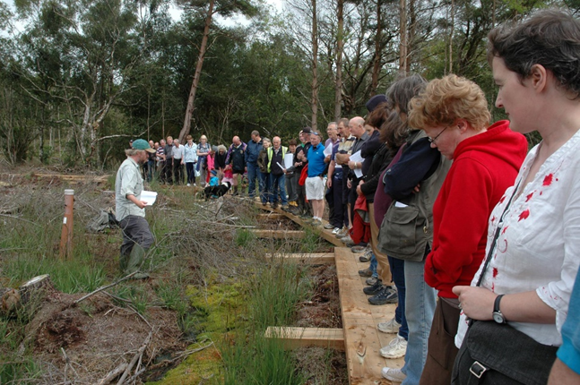
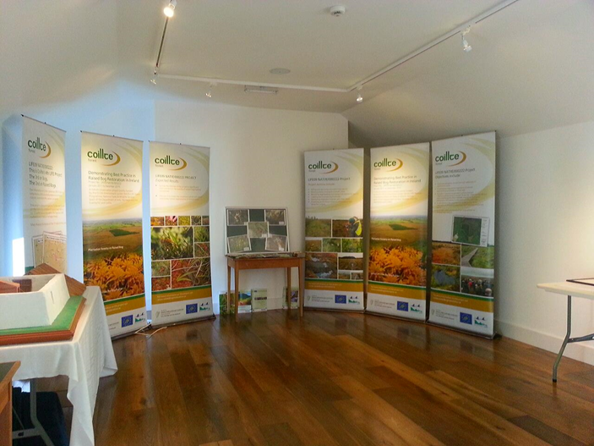
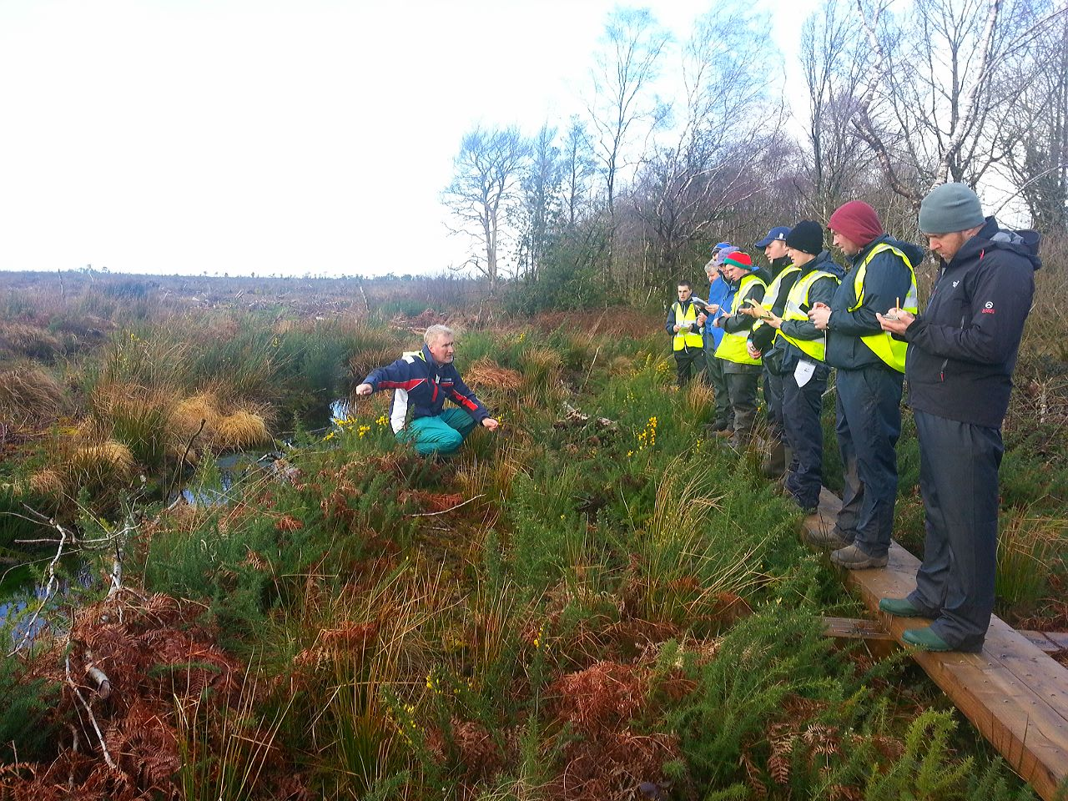
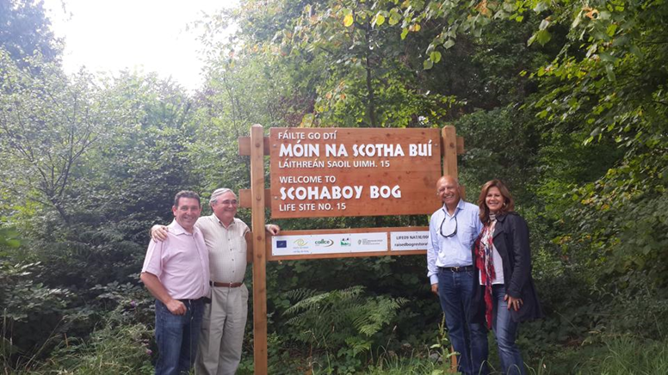
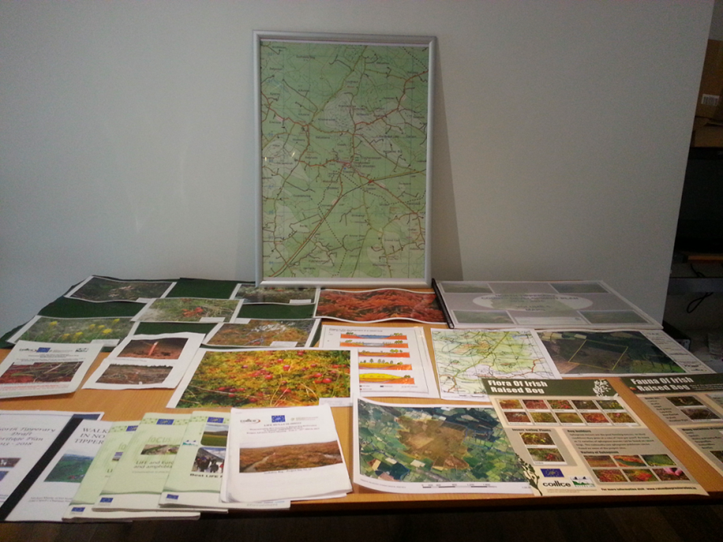
Building links….
With local community & stakeholders
Third level institutions
Cloughjordan Heritage Centre
the Royal Kingdom of Jordan

Slide 15
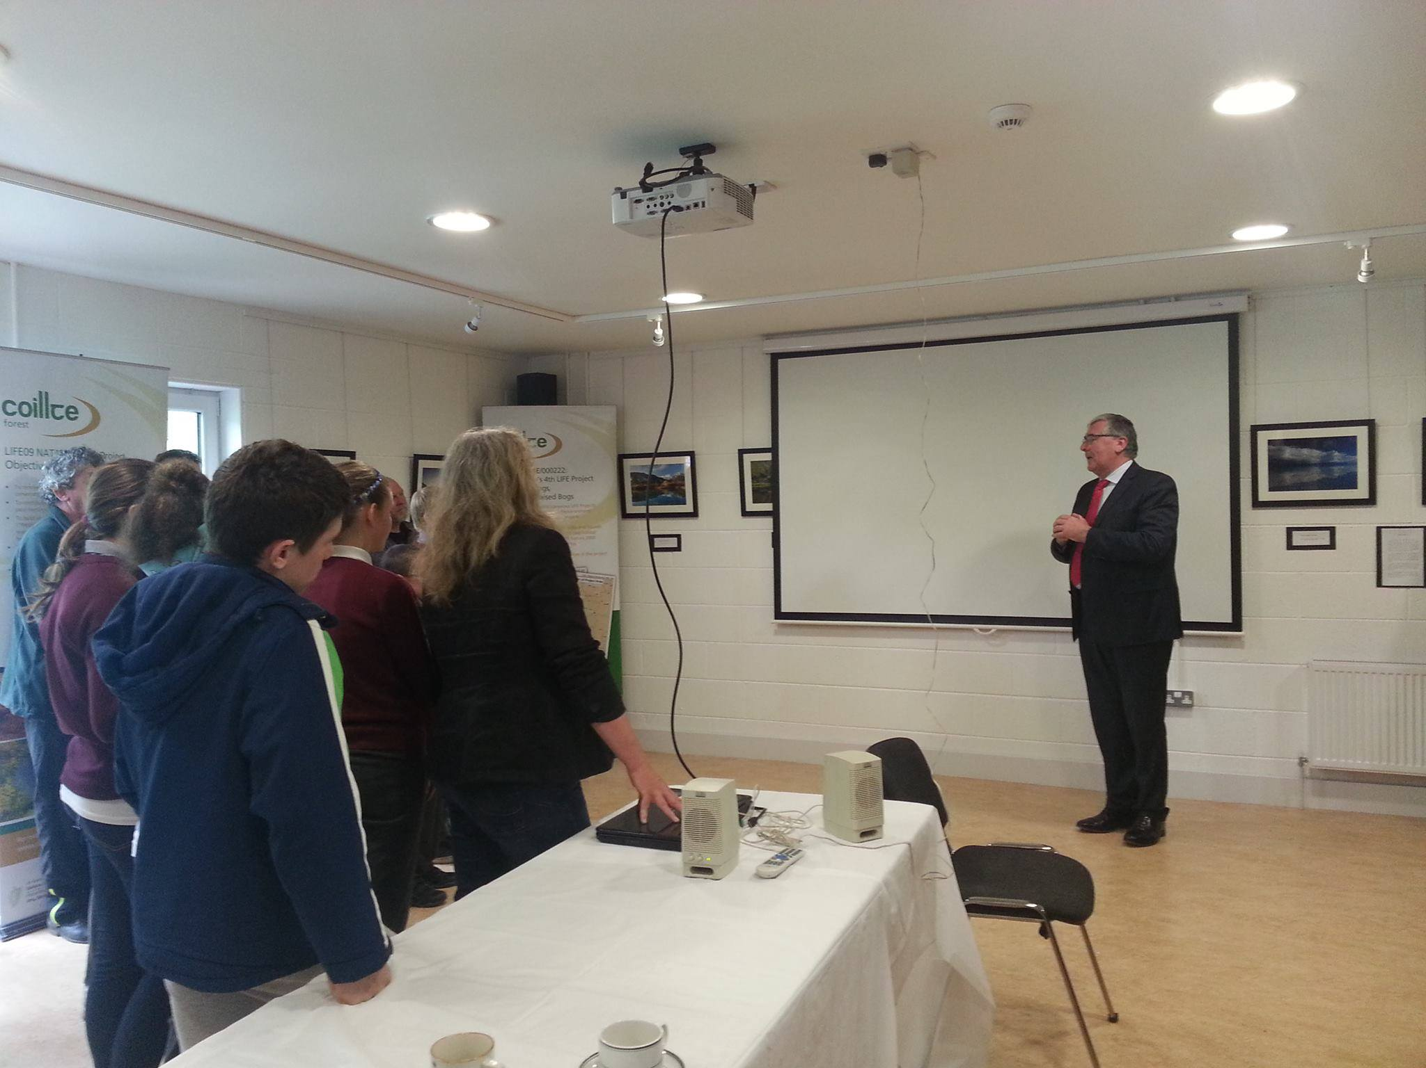
CCDC hosted the recent National project launch & presented on the local primary Schools May Day project

Slide 16
Knockanacree & Scohaboy
are award winning local projects :
2014 RDS Irish Forestry Awards.
Runners Up & Special Merit Award Winners in the Community Woodlands Category
Cloughjordan Tidy Towns Group :
Winners 2014 Notice Nature National Biodiversity Award

Slide 17
Quality of engagement from Coillte team….
Invaluable support from Coillte Team…..
Mary O Brien & John Moore. Brendan Lally
John Connolly & Sharon Byrne. Angela Wallace
Michael Collins
…Knockanacree & Scohaboy are excellent examples of how the State forestry company and a local community group can collaborate to develop and steward valuable natural heritage assets….

Slide 18
Scohaboy Bog – a local heritage asset and a `public good`.
Next steps ?
Developing community stewardship
Long term management plan/community input
Building educational links : local schools, LIT Thurles.
Develop link to heritage centre
A visitor attraction/local cycle route
Local `bog guides`/ ISPCC Training link?
Looped walk development in Sopwell Woodlands as spur off Beara-Breifne Trail.

Slide 19
…….as well as the science – Scohaboy is a place of “encounter”
- a wonderful local natural heritage asset , a space to linger awhile in the quietness and open space
- a place where on a warm summer months evening, the Fuiseog (Lark) fills the air with it`s melodious song of high summer.

