Slide 1
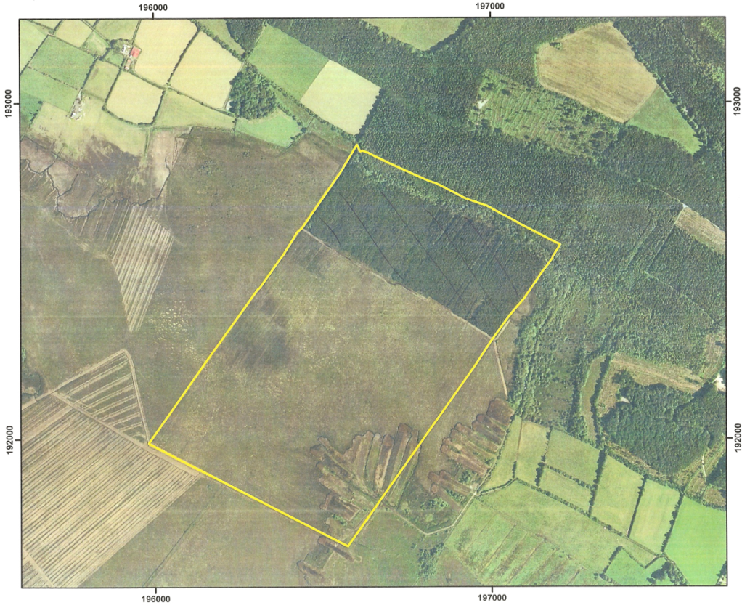
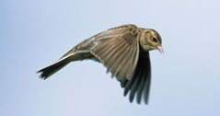
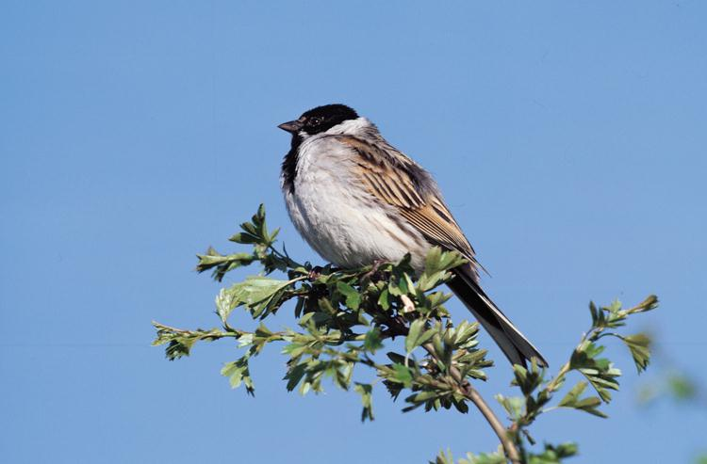
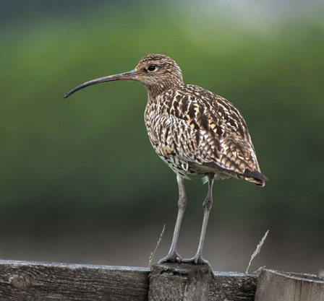
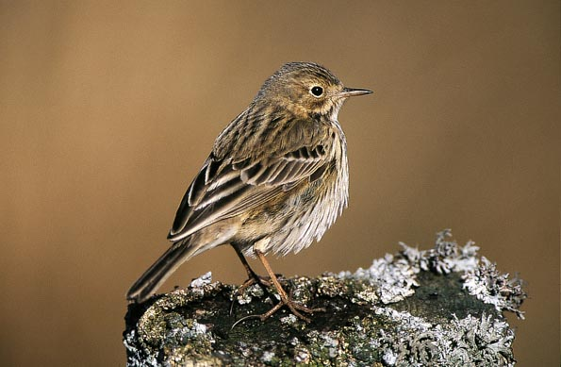
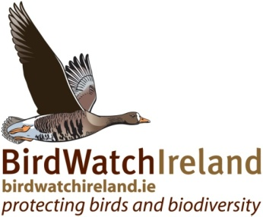
Impacts of Raised Bog Restoration on Birds Alex Copland
LIFE09 NAT/IE/000222 "Demonstrating Best Practice in Raised Bog Restoration in Ireland“ which is funded by the EU, NPWS and Coillte - see www.raisedbogrestoration.ie

Slide 2
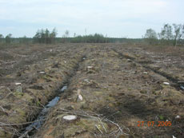
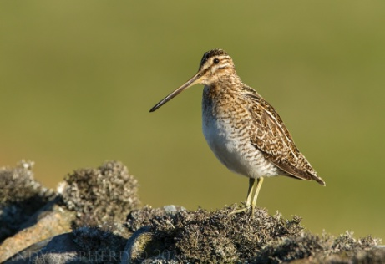
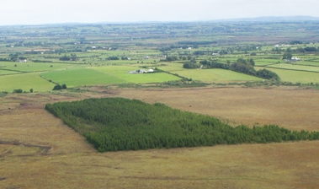
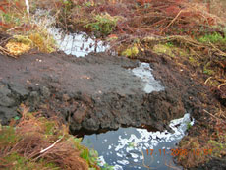
Raised Bog Restoration
Removal of conifers
Blocking drains
LIFE09 NAT/IE/000222 "Demonstrating Best Practice in Raised Bog Restoration in Ireland“ which is funded by the EU, NPWS and Coillte - see www.raisedbogrestoration.ie

Slide 3
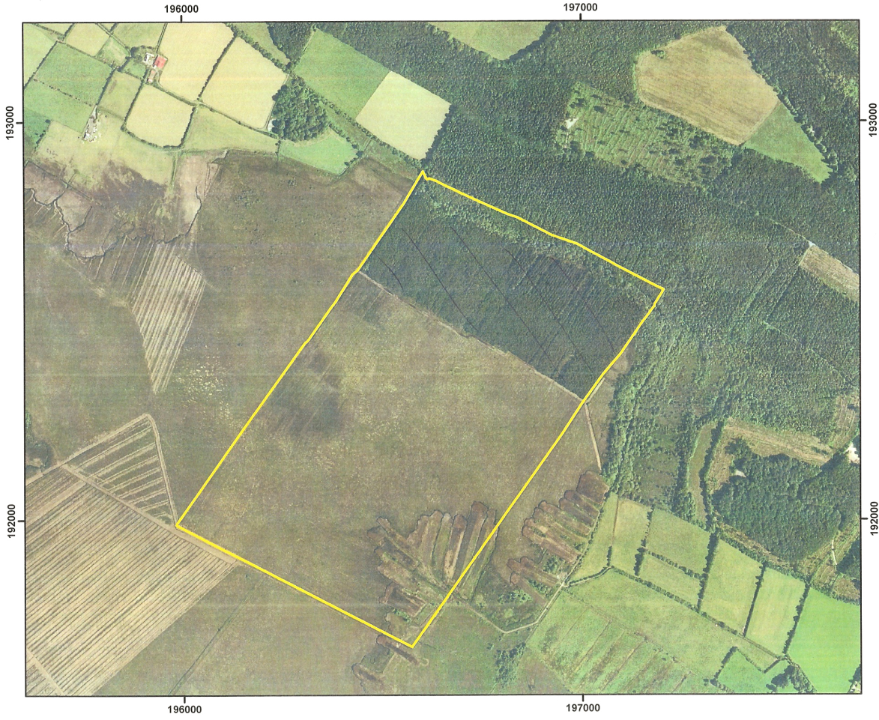
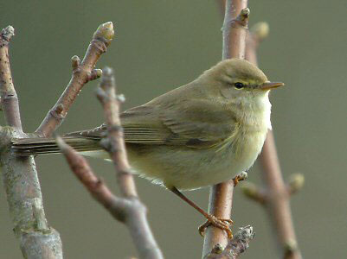
Data collection
Four survey sites (Girley Bog, Lough Forbes, Scohaboy Bog & Ballygar Bog)
Transects walked in 2012 (baseline)
Same routes walked in 2015
Bird and habitat data collected
LIFE09 NAT/IE/000222 "Demonstrating Best Practice in Raised Bog Restoration in Ireland“ which is funded by the EU, NPWS and Coillte - see www.raisedbogrestoration.ie

Slide 4
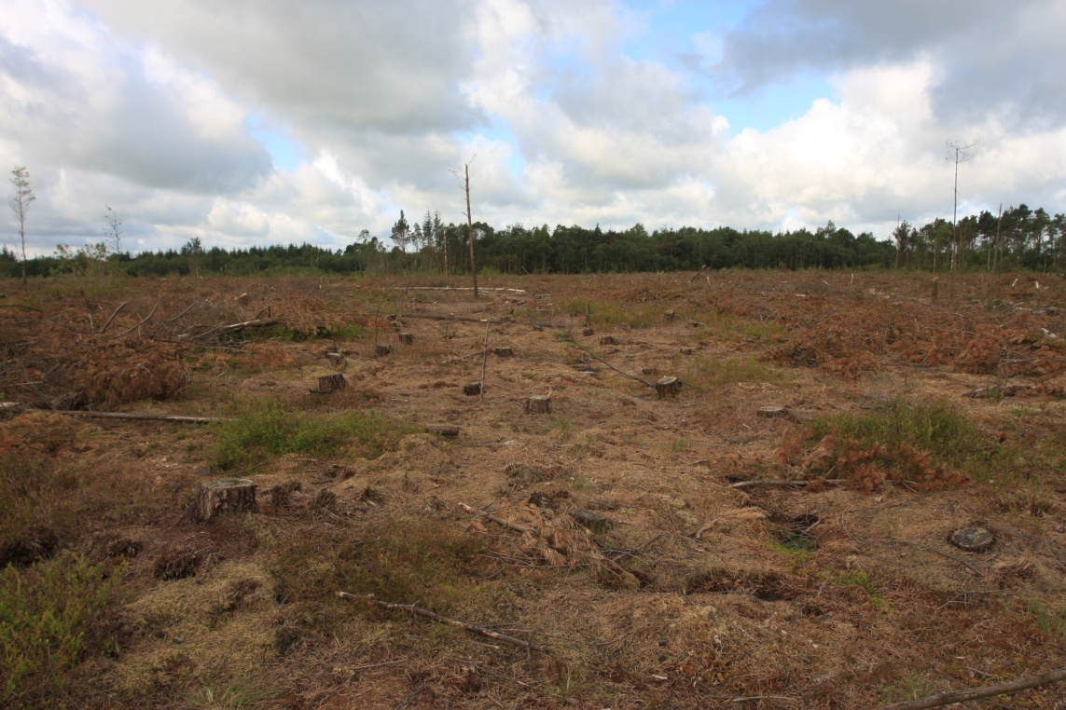
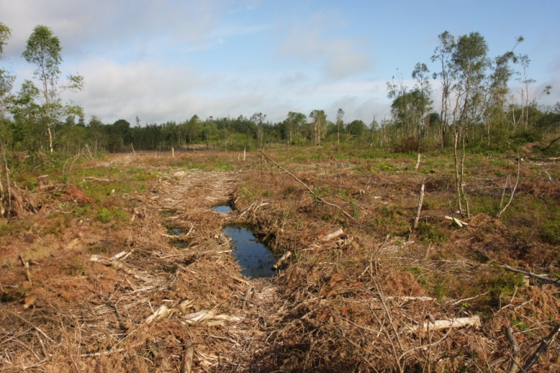
Results
Overall transect length 7,682m
Five habitat categories:
Conifers
Woodland
Open clearfell
Dense clearfell
Bog
Four habitat niches:
Conifer (specialist)
Bog (specialist)
Woodland (generalist)
Other (generalist)
LIFE09 NAT/IE/000222 "Demonstrating Best Practice in Raised Bog Restoration in Ireland“ which is funded by the EU, NPWS and Coillte - see www.raisedbogrestoration.ie

Slide 5
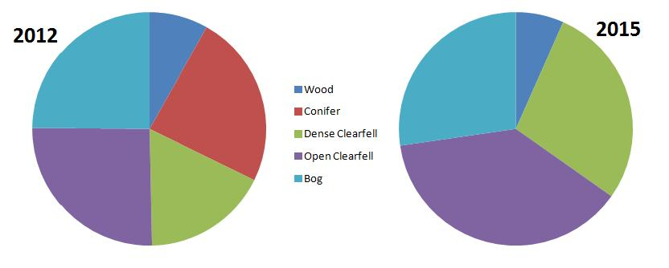
Habitat Results
LIFE09 NAT/IE/000222 "Demonstrating Best Practice in Raised Bog Restoration in Ireland“ which is funded by the EU, NPWS and Coillte - see www.raisedbogrestoration.ie

Slide 6
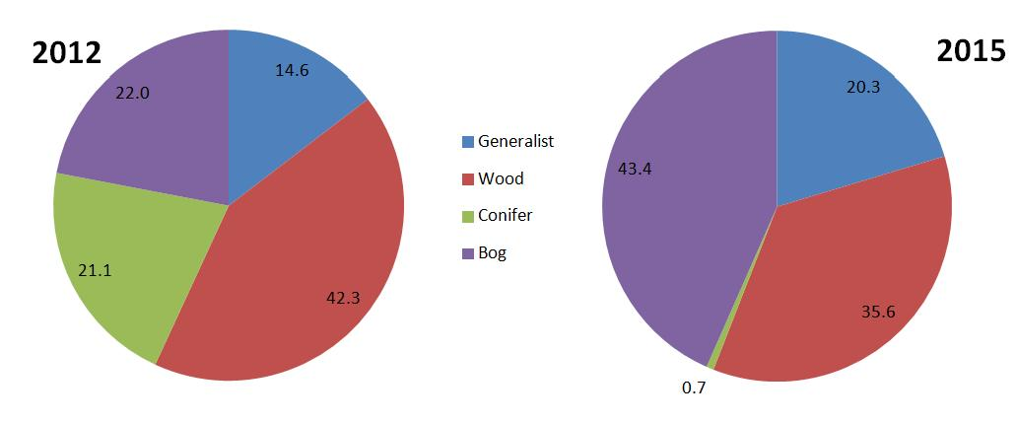
Bird Results
LIFE09 NAT/IE/000222 "Demonstrating Best Practice in Raised Bog Restoration in Ireland“ which is funded by the EU, NPWS and Coillte - see www.raisedbogrestoration.ie

Slide 7
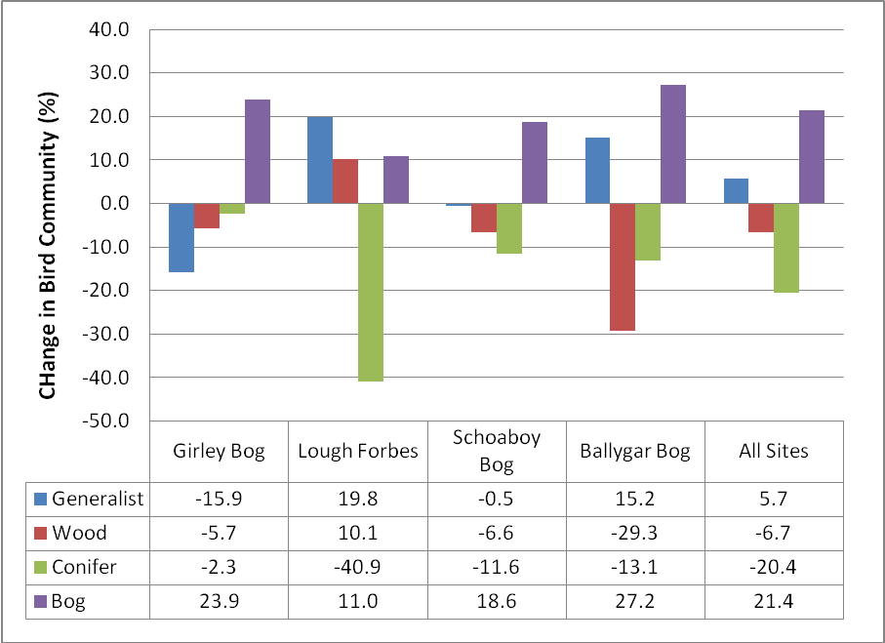
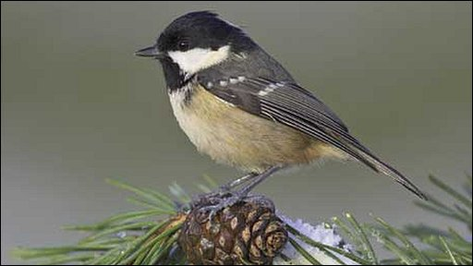
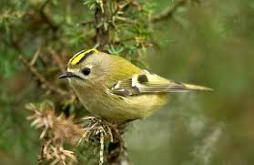
Bird Results
LIFE09 NAT/IE/000222 "Demonstrating Best Practice in Raised Bog Restoration in Ireland“ which is funded by the EU, NPWS and Coillte - see www.raisedbogrestoration.ie

Slide 8
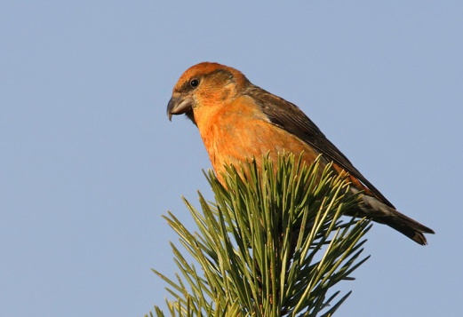
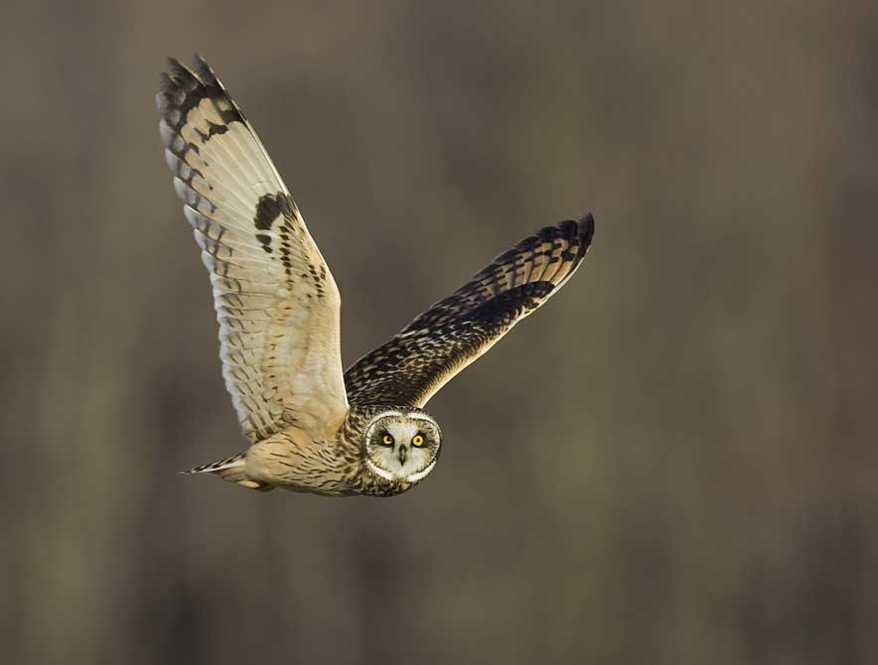
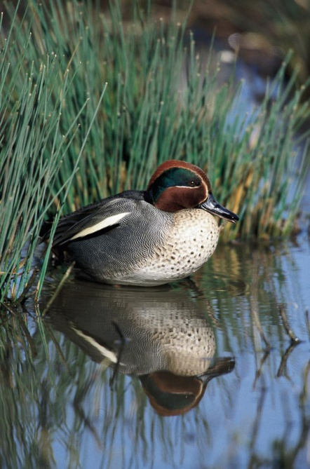
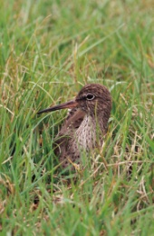
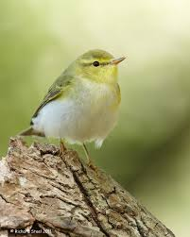
Interesting species
LIFE09 NAT/IE/000222 "Demonstrating Best Practice in Raised Bog Restoration in Ireland“ which is funded by the EU, NPWS and Coillte - see www.raisedbogrestoration.ie

Slide 9
Future Prospects
Continued habitat stability and re-wetting will benefit birds
Removal of brash volumes would hasten bird usage (balance of micro- and macro-habitat structure and rehabilitation).
Care of scrub encroachment and/or regeneration
LIFE09 NAT/IE/000222 "Demonstrating Best Practice in Raised Bog Restoration in Ireland“ which is funded by the EU, NPWS and Coillte - see www.raisedbogrestoration.ie

Slide 10
Thank you!
LIFE09 NAT/IE/000222 "Demonstrating Best Practice in Raised Bog Restoration in Ireland“ which is funded by the EU, NPWS and Coillte - see www.raisedbogrestoration.ie

